Slide 1



Short-Term Lodgings and Rentals
COMMUNITY MEETING
June 21, 2016

Slide 2
January 2016 City Council Study Session
Council is interested in:
  Public outreach. Stakeholder discussions.
  Filling in gaps on the Peninsula for vacation rentals?
  Adopting regulations for Homesharing?
  Adopting standard operational guidelines for vacation rentals?
  Pursuing agreements with the online services to disclose rental information and submit TOT to City.

Slide 3
Progress To Date
Public outreach.
  March 23rd Public Meeting
  Newport Beach Association of Realtors
  Balboa Island Improvement Association
  Individual meetings with Residents and Realtors
Evaluated in gaps in limited R-1 zone areas on the Peninsula
Defined Homesharing
Drafted expanded operational standards for vacation rentals
Pursued agreements with the online services to disclose rental information and submit TOT to City.

Slide 4
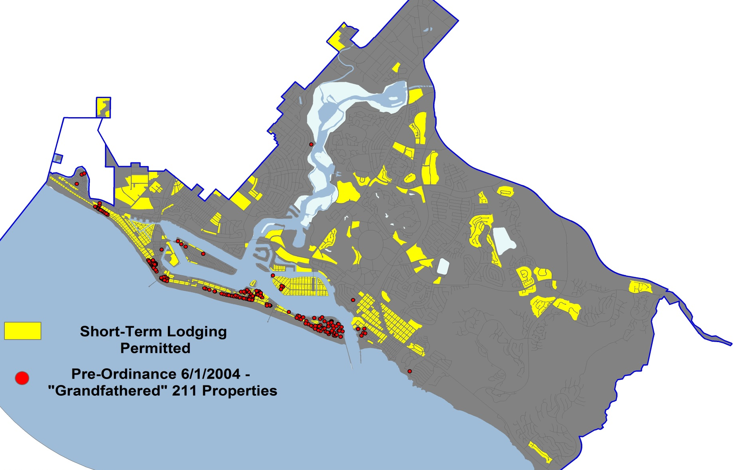
Short-Term Lodging Permitted

Slide 5
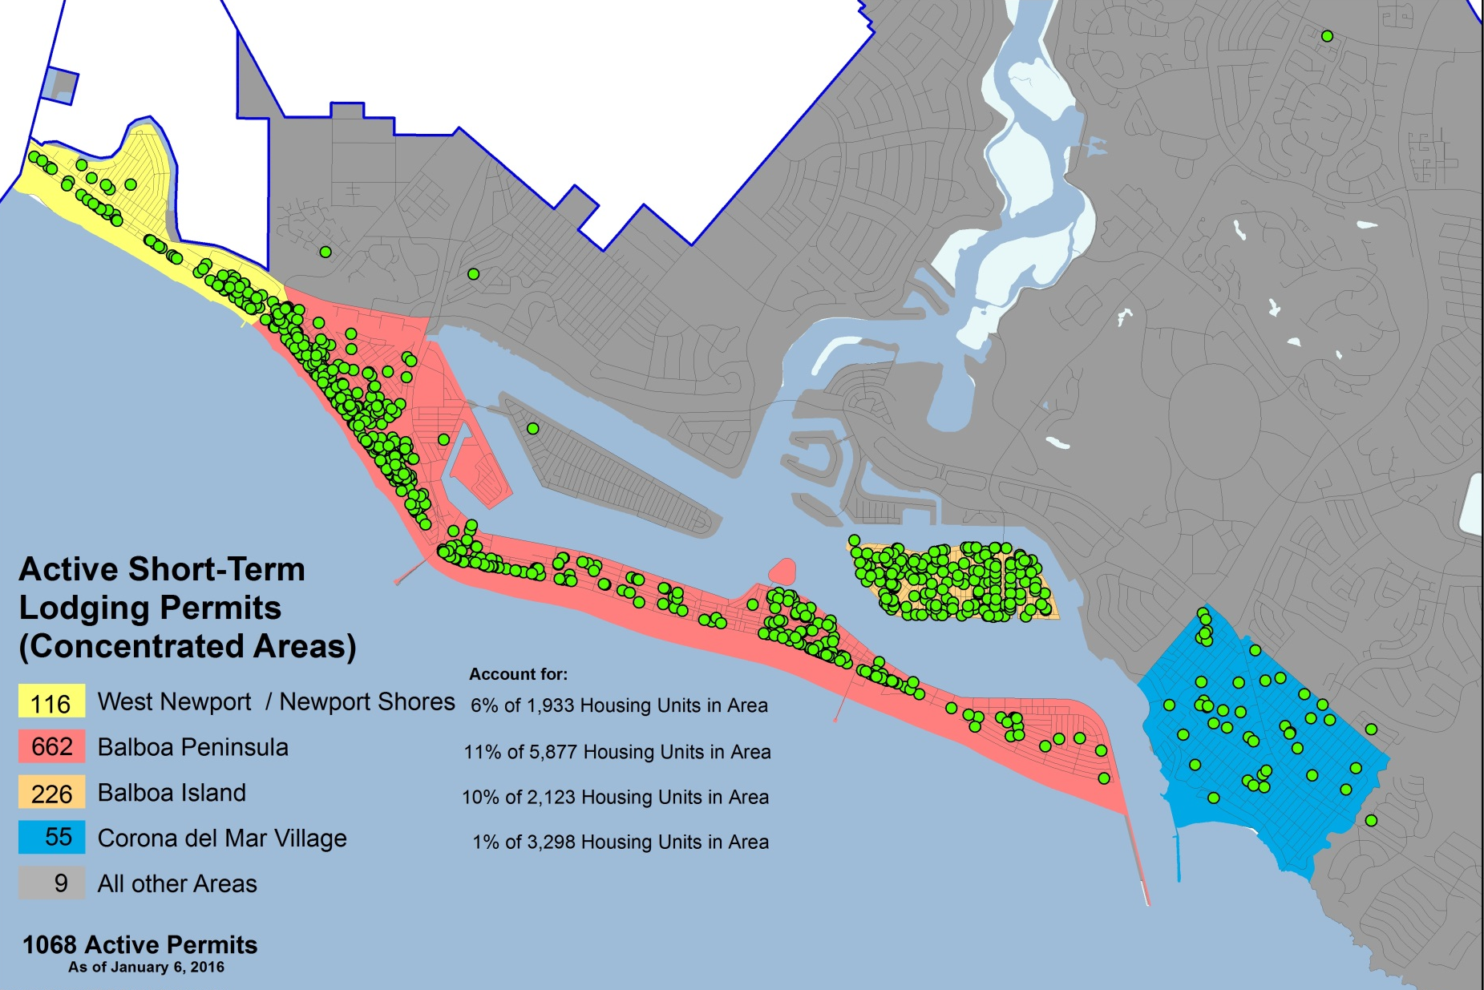
Active Short-Term Lodging Permits
Concentrated Areas

Slide 6
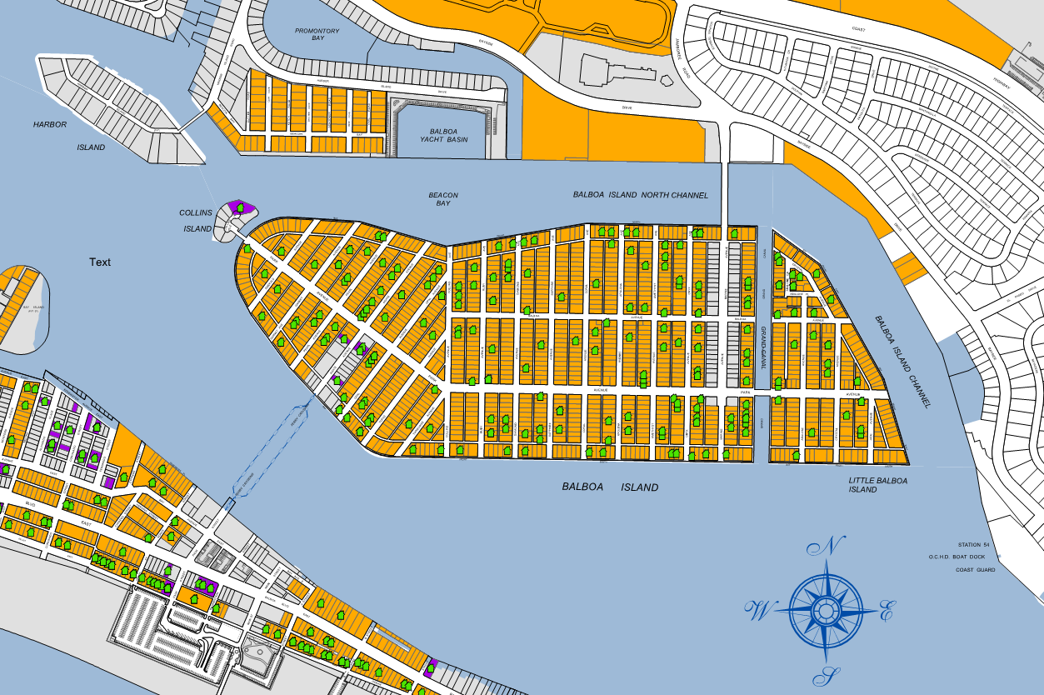
Balboa Island Active Permits

Slide 7
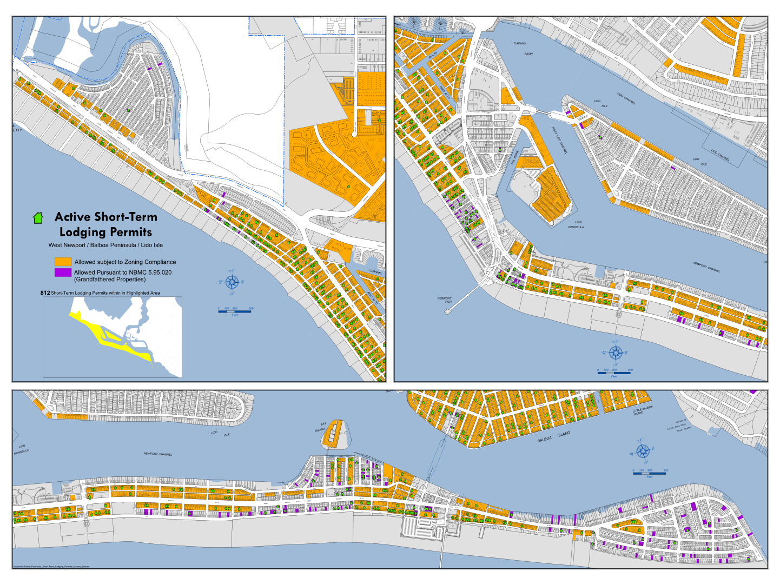
Filling in the Gaps??
Should Single-Family Districts where STL has been grandfathered allow additional STL permits?

Slide 8
Filling in the Gaps??
Many of the R-1 areas were created in 1989 because of small lots. Others were always R-1.
Interest to preserve single-family character.
  RECOMMENDATION: No change to areas where STL is permitted

Slide 9

Homesharing – What is that?
Typical vacation rentals are for entire units, and the owners are not present.
Homesharing means that the owner is present, who rents out a bedroom or even a couch on a short-term basis.
“Homesharing” is already permitted, but a definition is needed.
An example of “Homer-sharing”

Slide 10
Homesharing- continued
RECOMMENDATION: Create Definition
  “Short term” shall mean occupancy of a lodging unit for a period of thirty (30) consecutive calendar days or less. This also includes a maximum of one written or oral rental agreement within a lodging unit for a period of thirty (30) consecutive calendar days or less, wherein the owner, tenant, agent, or rental manager is the long-term occupant of the lodging unit and is residing at the lodging unit during the term of the rental agreement.

Slide 11
Operational Standards
Interior Notification | Exterior Notification | Other
Name of local contact person on a 24 hour basis. Local contact must be within 10 miles of the unit | Shall display a notice on the exterior that is legible and visible to general public | Max. Occupancy: 2 adults (18 yrs or older) per bedroom
Number & location of on-site parking | Local contact person phone number that is within 10 miles of unit | Provide City with local contact person information
Trash pick up day and posting of rules related to trash services | Short Term Lodging Permit number | Short term lodging permit to be displayed on all advertisements
Street Sweeping Day | City website address, Police Department phone, Code Enforcement phone | Unregistered/Non Compliant Units will be required to vacate the guests from the unit within 24 hours
Notice that guests are responsible for all activities, violations will result in fines. |  | No Commercial activities

Slide 12
Code Enforcement
Enforcement is key
  2015 – 23 Administrative Citations Issued
  June 2015 – seasonal employee hired to assist in enforcement
    Over 250 non-compliant on-line listings identified
    Of those, 131 obtained the required permits
    City collected $218,700 in fees and TOT as a result of the enforcement effort
Increased Enforcement
  Summer 2016 – Seasonal employee to focus on on-line listings
  Proactive Enforcement Program
  Noise Abatement: DAC/LUGO Enforcement
  Use of Tier 2 Fines ($1,000, $2,000, $3,000)

Slide 13
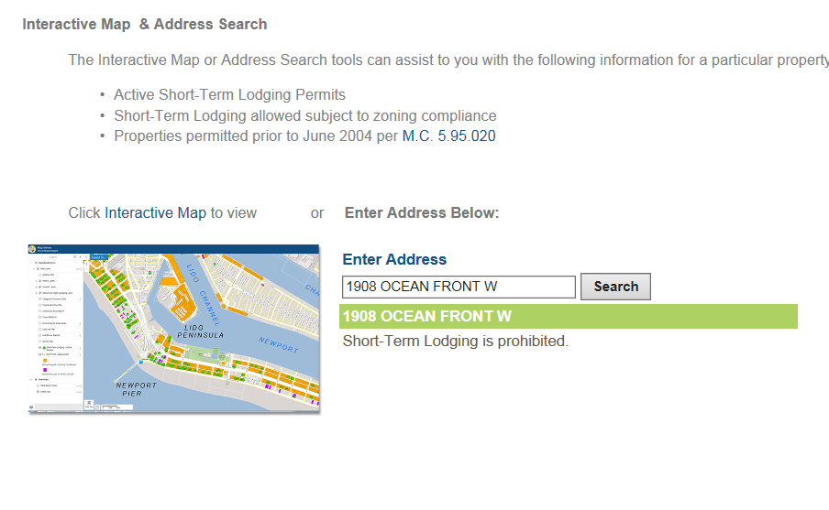
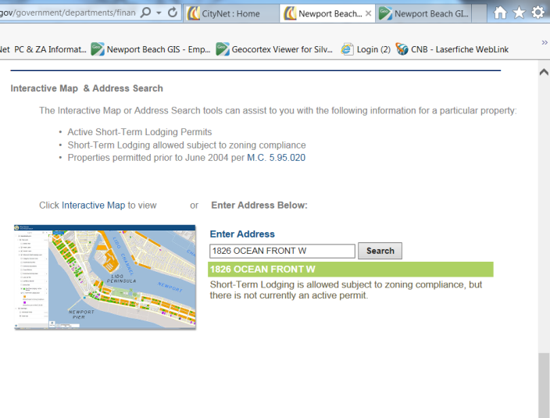
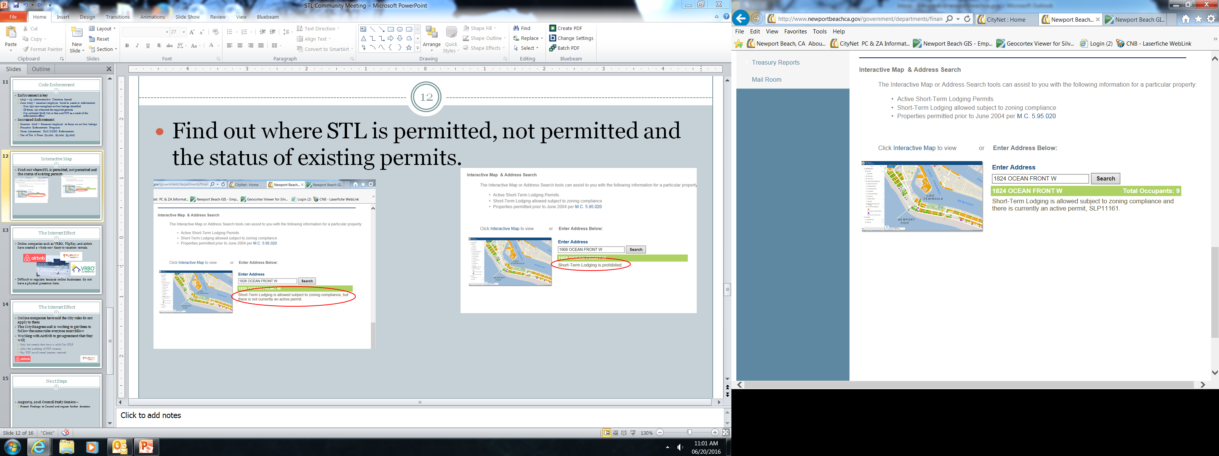
Interactive Map
Find out where STL is: permitted, not permitted and the status of existing permits.
PROHIBITED
PERMITTED
PERMIT STATUS

Slide 14




The Internet Effect
Online companies such as VRBO, FlipKey, and airbnb have created a whole new facet to vacation rentals.
Difficult to regulate because online businesses do not have a physical presence here.

Slide 15
The Internet Effect
Online companies have said the City rules do not apply to them
The City disagrees and is working to get them to follow the same rules everyone must follow
Working with airbnb to get agreement that they will:
  Only list rentals that have a valid City STLP
  Allow for auditing of TOT revenue
  Pay TOT on all rental income received

Slide 16
Next Steps
August 9, 2016 City Council Meeting–
  Present Findings to Council and request further direction.

Slide 17

Questions

