Slide 1
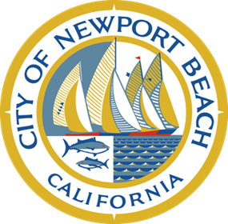
Poppy Avenue Landscaping and Street Reconstruction from Coast Highway to Ocean Blvd. Conceptual Design Community Meeting December 9, 2015
Public Works and
Municipal Operations Departments

Slide 2
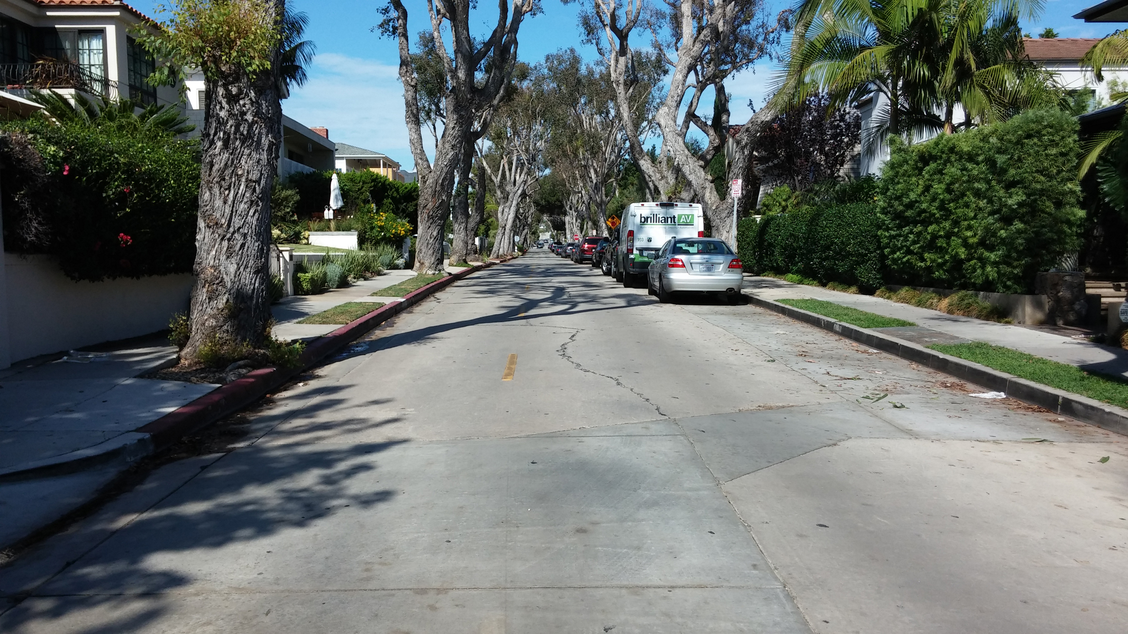
Poppy Ave
Existing Condition
City of Newport Beach, CA

Slide 3
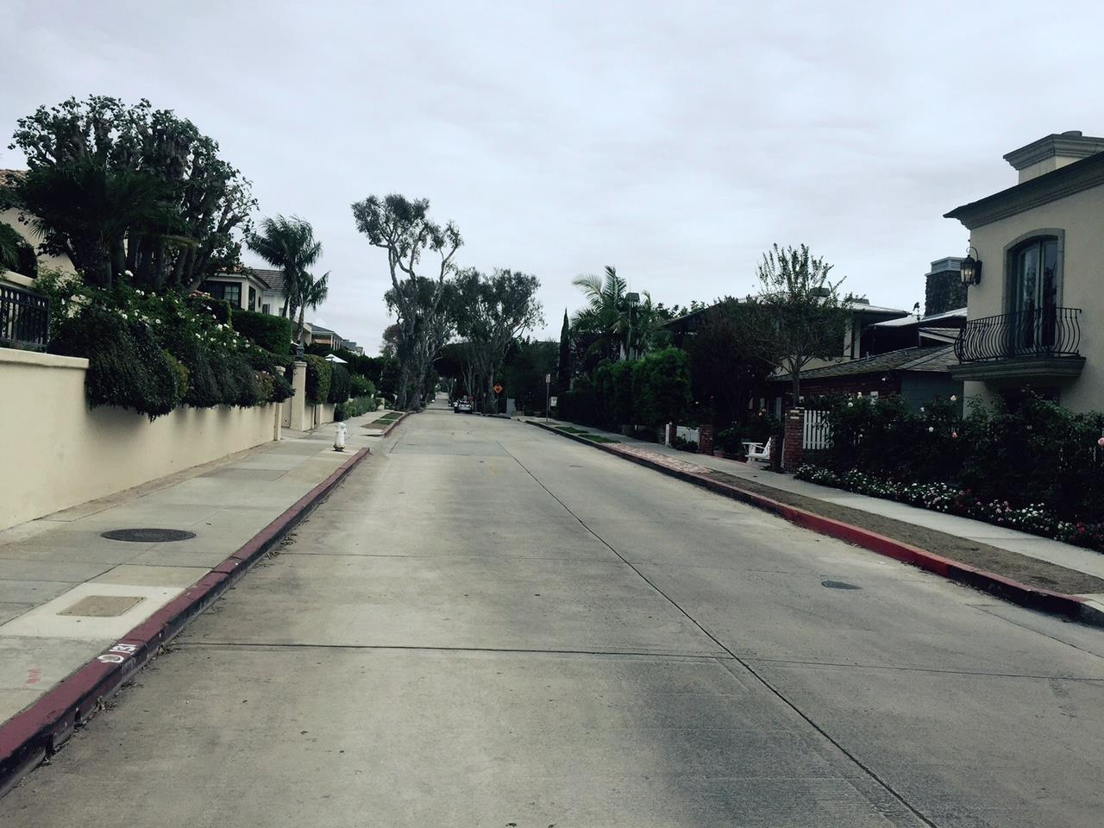
Poppy Ave
Existing Condition
City of Newport Beach, CA

Slide 4
Existing Sidewalk – Sections
4-foot wide sidewalk
2 ½ -foot wide parkway
1-foot public area behind the sidewalk
Some walls encroach in the 1-foot area

Slide 5
New Sidewalk - Sections
4.0
3.5
3.0
3.5
4-foot wide sidewalk, meandering at tree locations
2 ½ -foot wide typical parkway (existing)
3-foot wide tree wells and 3 ½- foot wide sidewalk at locations with private property wall encroachments
3 ½-foot wide tree wells and 4-foot wide sidewalks at areas without wall encroachments

Slide 6
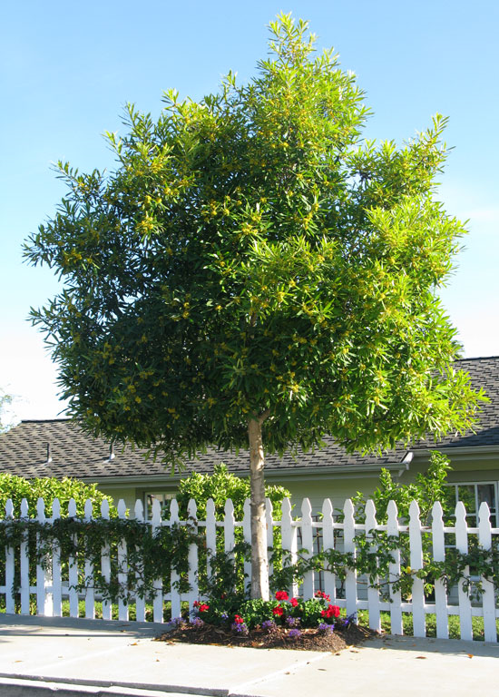
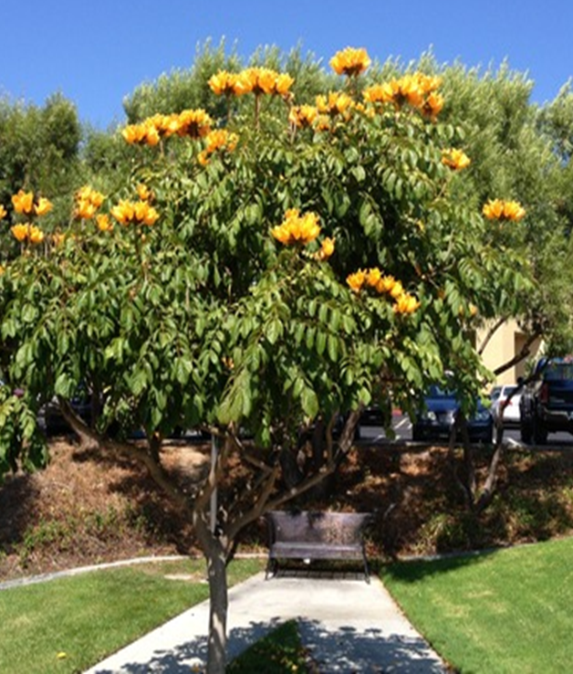
Top 2 Tree Recommendations
Water Gum
Tristania laurina
African Tulip Tree
Spathodea campanulata

Slide 7
Recommendations
Nov. 9th Community meeting consensus:
Keep parking as-is
Keep sidewalk on both sides
Utilize the 1-foot public area behind the sidewalk
Re-landscape with trees
Dec. 9th items:
Sidewalk width and location similar to existing
Tree selection - City recommendation: 24/36-inch box trees
1. Water Gum Tree
2. African Tulip Tree
3. Alternative – Crape Myrtle
Construction:
Project will replace most of the street, concrete and trees
Residents will continue to landscape parkways
Public Works and
Municipal Operations Departments

Slide 8

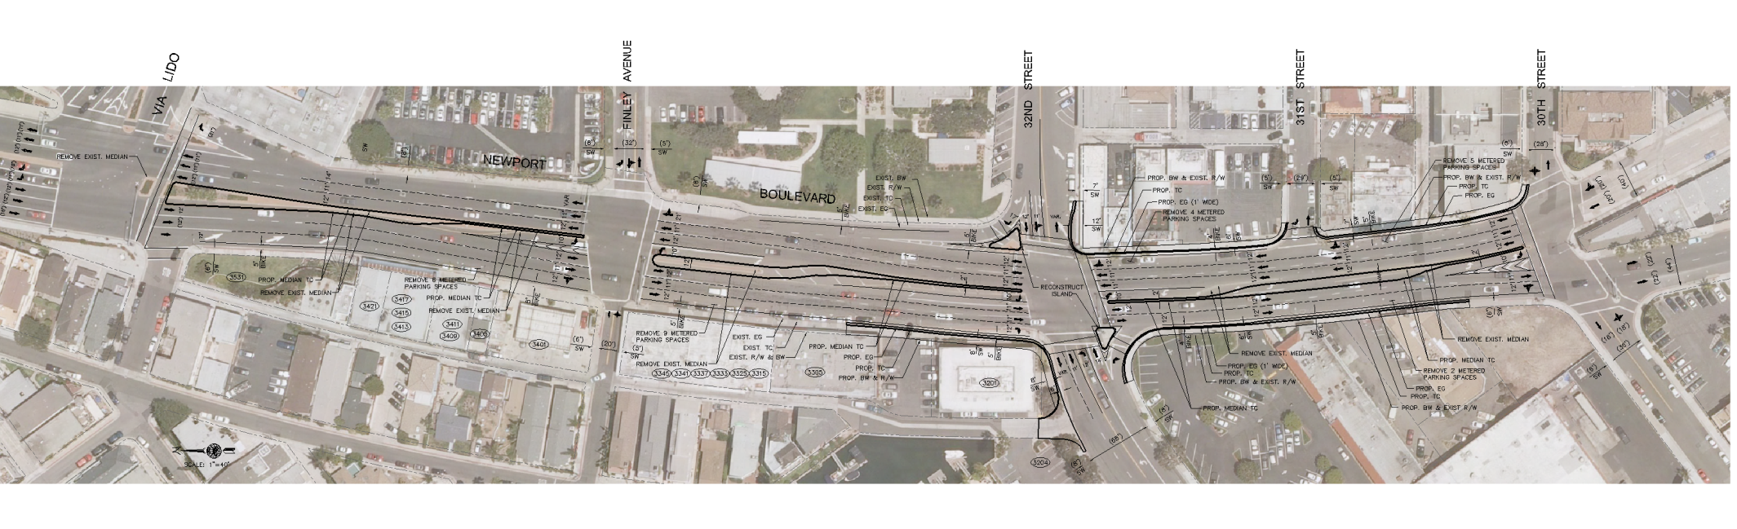
Next Steps
Concept approval
Design and Engineering
January thru Summer 2016
Construction
Fall of 2016
Public Works and
Municipal Operations Departments

Slide 9
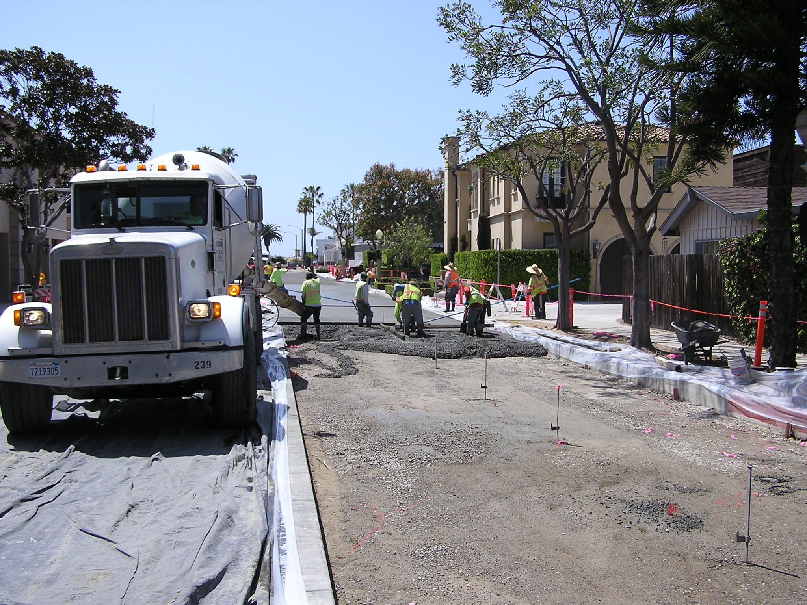
Upcoming Construction

