Slide 1
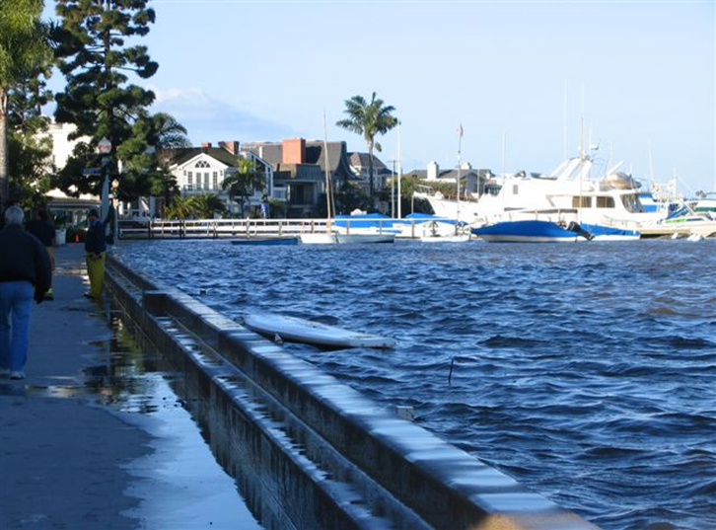
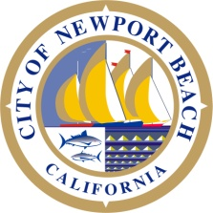
Balboa Islands Seawall Rehabilitation Project

Slide 2
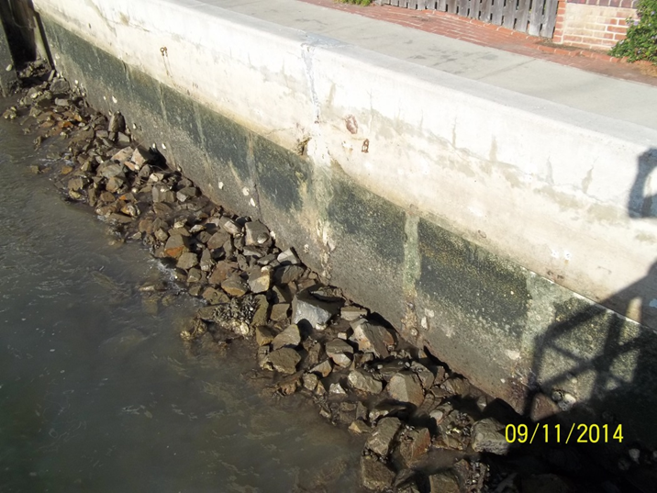
Two primary Issues
1) Need to address the structural condition of the aging seawalls.
2) Need to consider sea level rise when setting a top elevation of the new wall or cap.

Slide 3
Table of Contents
Overview
Existing Conditions
Overtopping concerns (Sea Level Rise)
Flood Potential
Minimum Top of Wall Elevation
Seawall Replacement, Rehabilitation or Raised Cap
Costs
Jetty Tide Gate
Beach and Dock Access
Other Considerations
Ferry Landing
Storm Drain Collection System

Slide 4
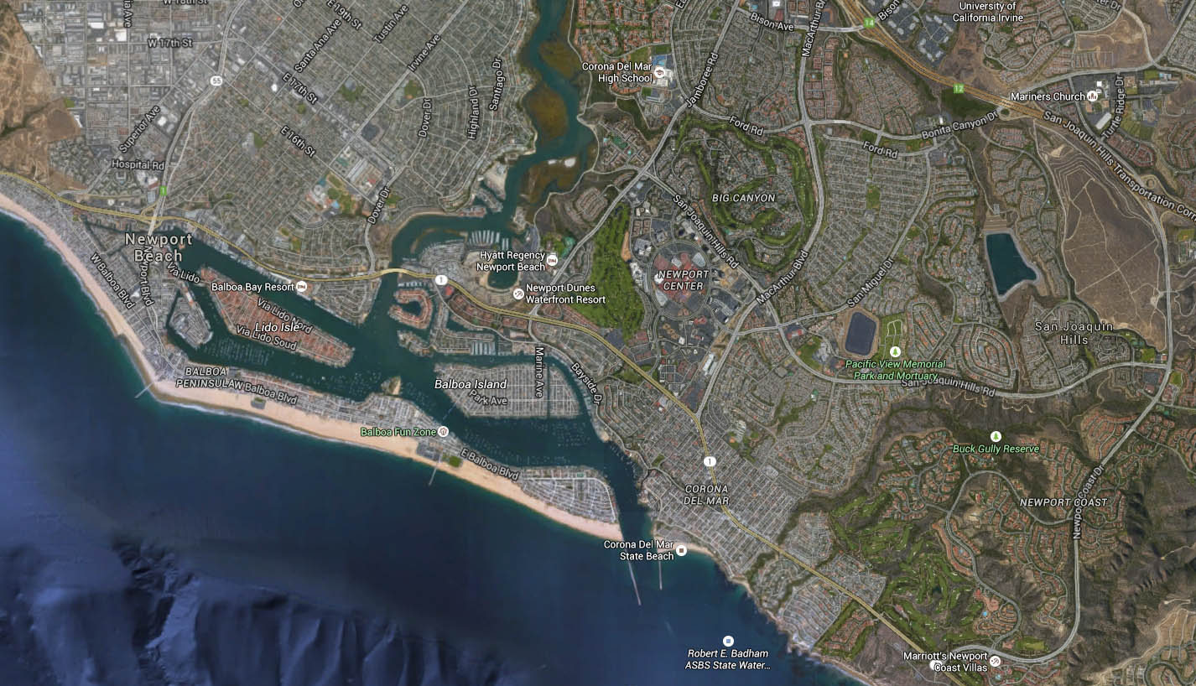
Newport Harbor Overview

Slide 5
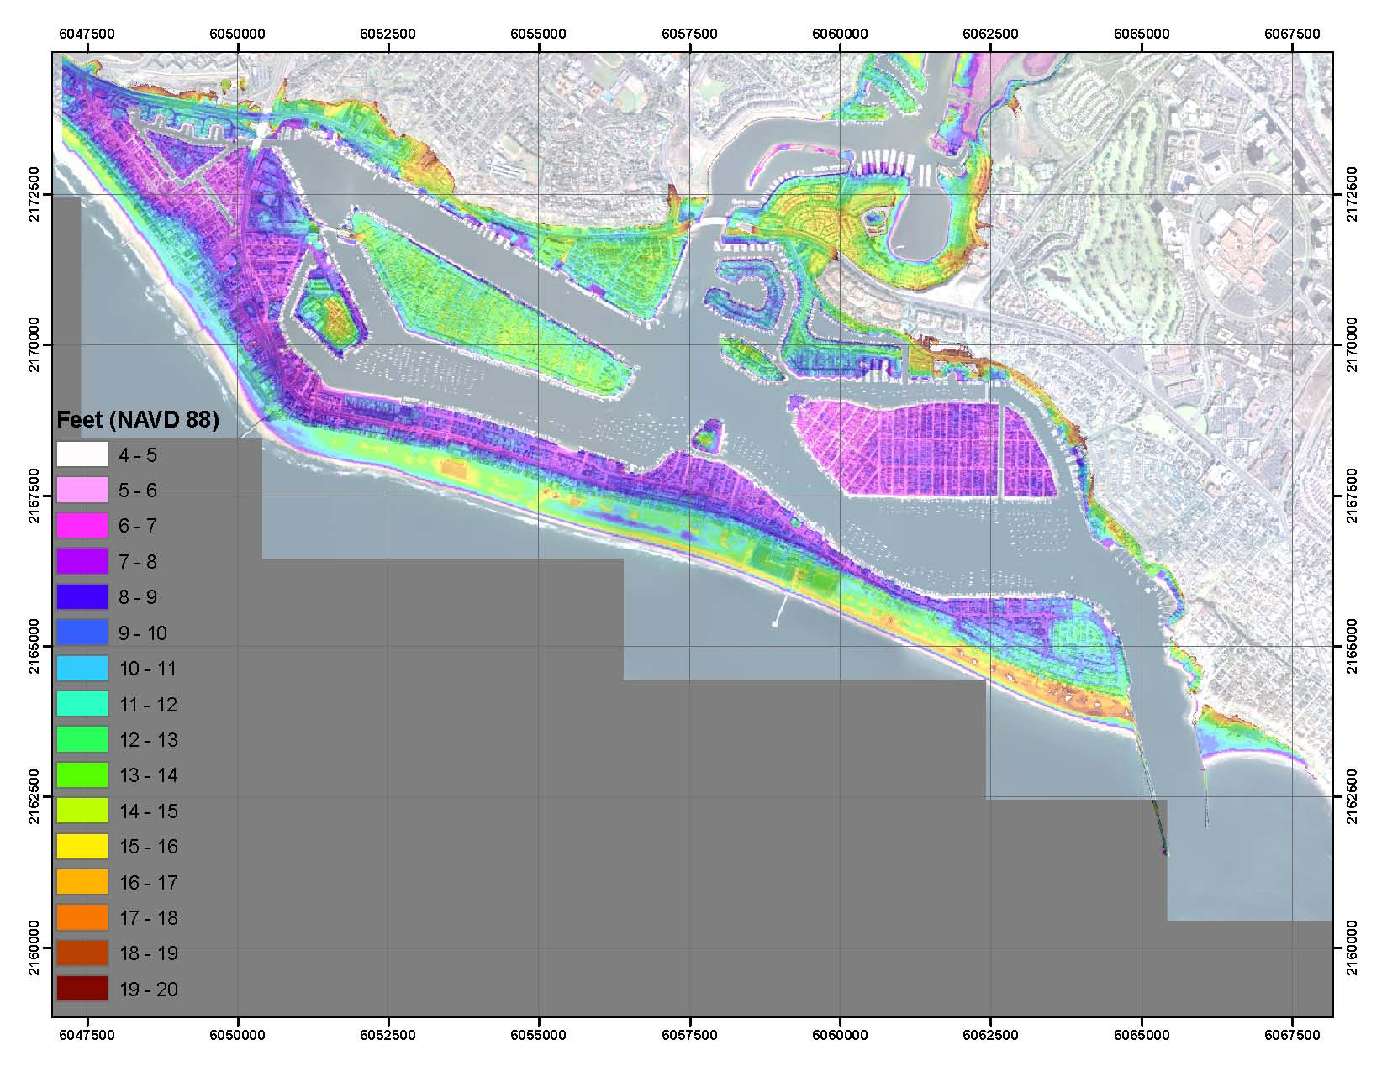
Low-Lying Areas Around the Harbor

Slide 6
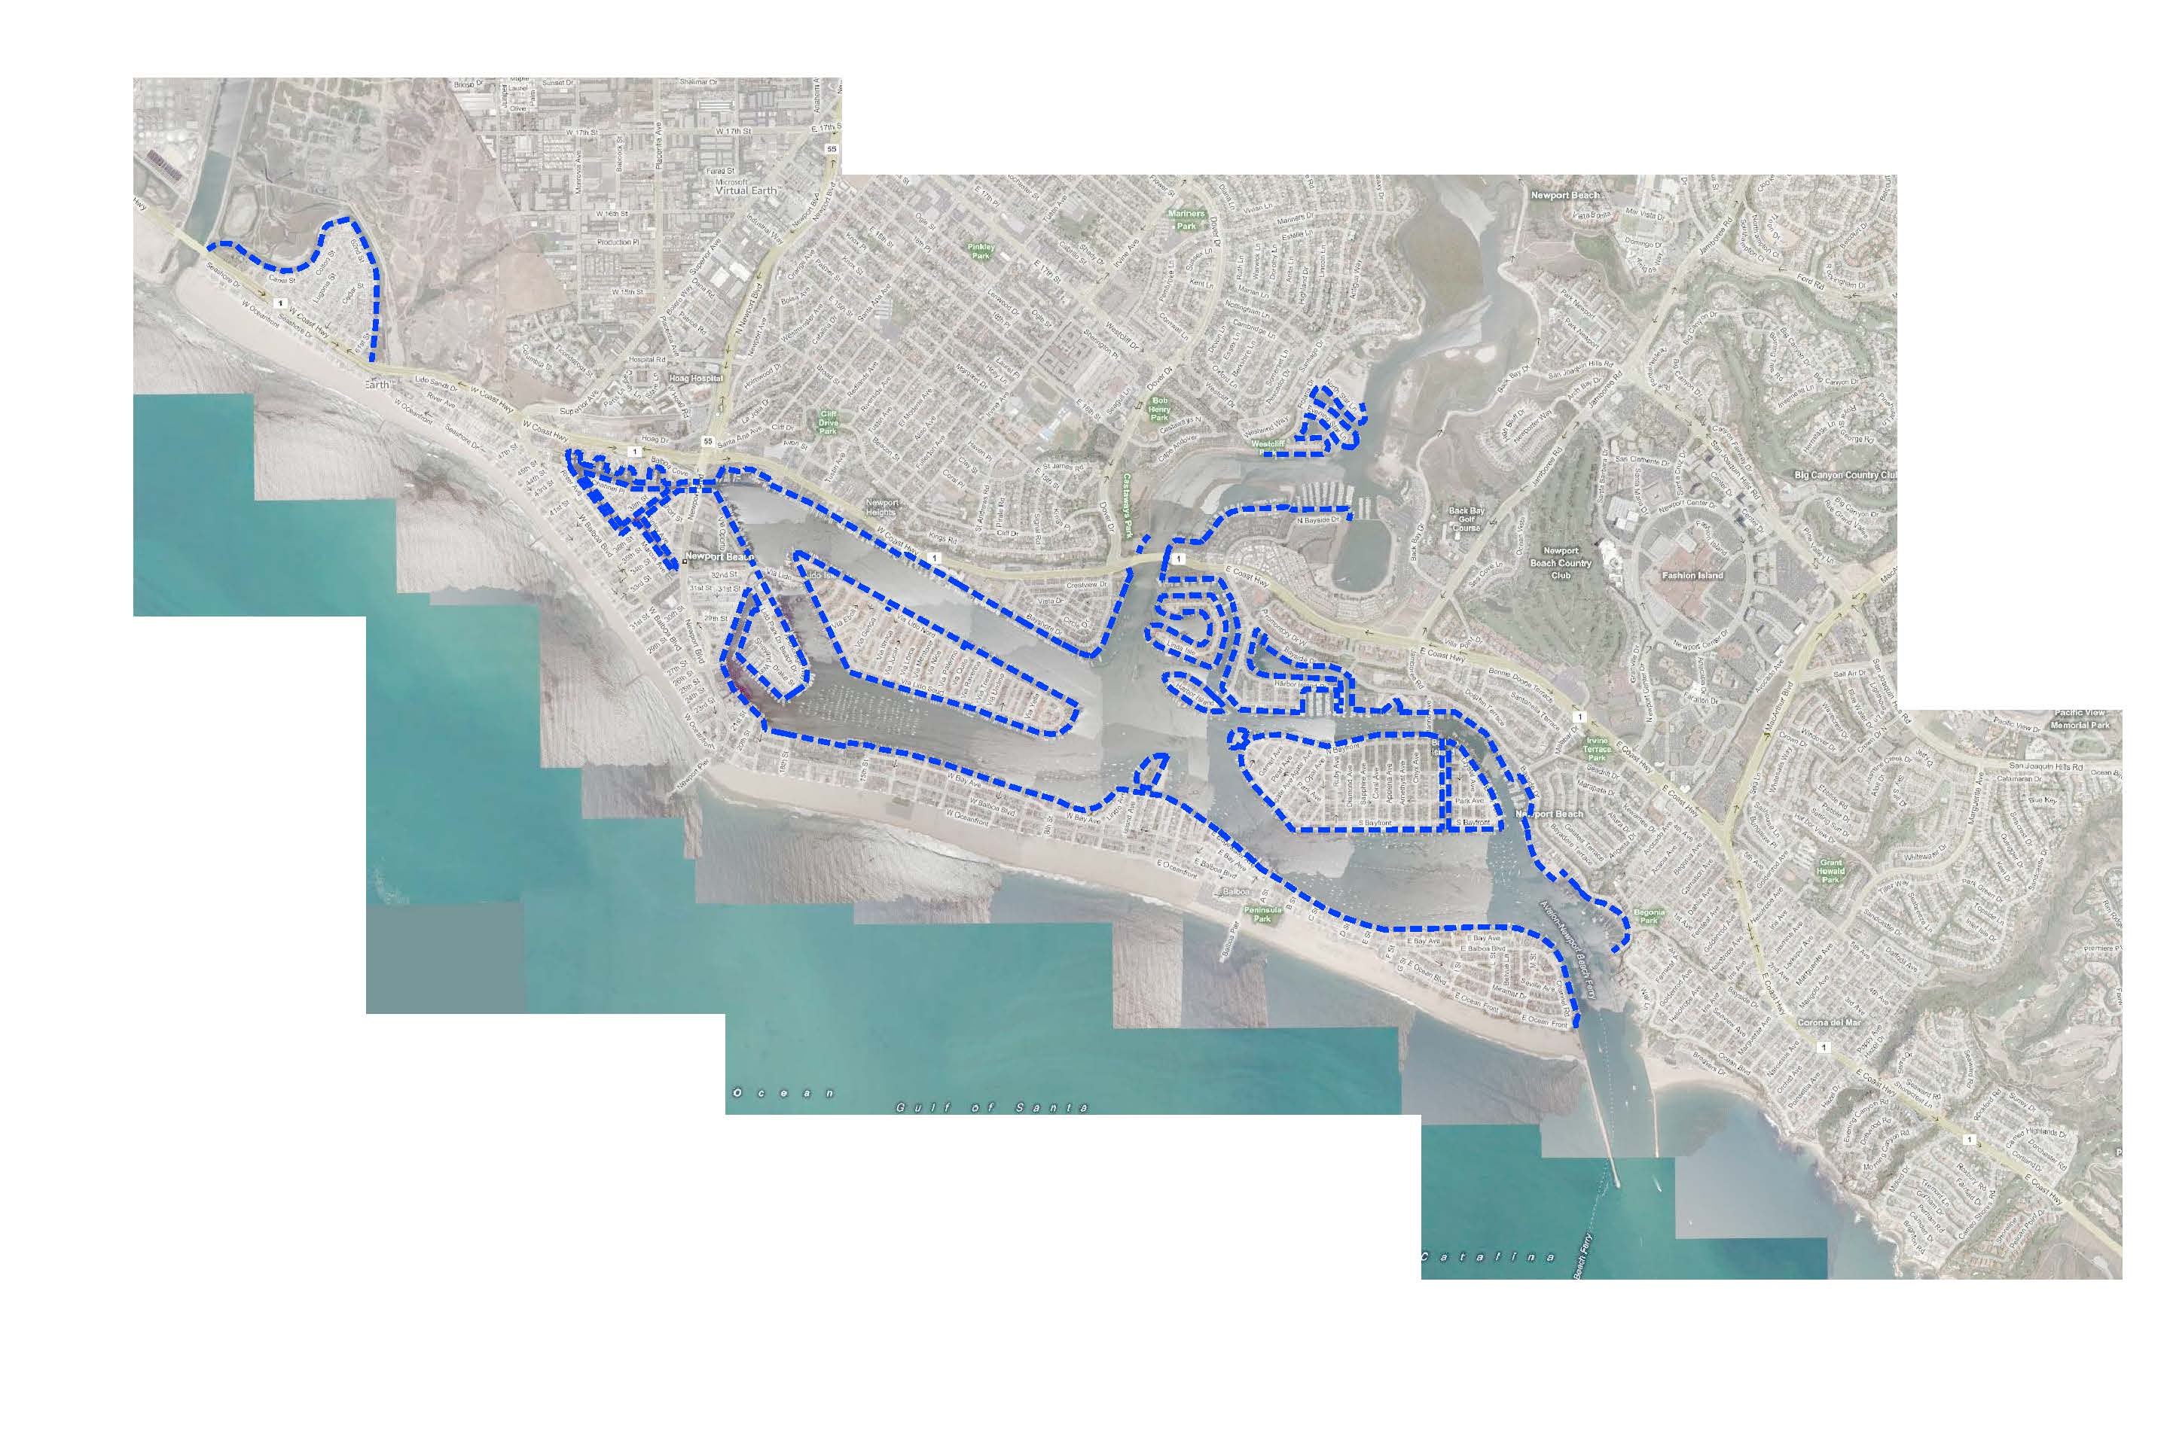
Public and Private Bulkheads and Seawalls (fix exhibit)

Slide 7
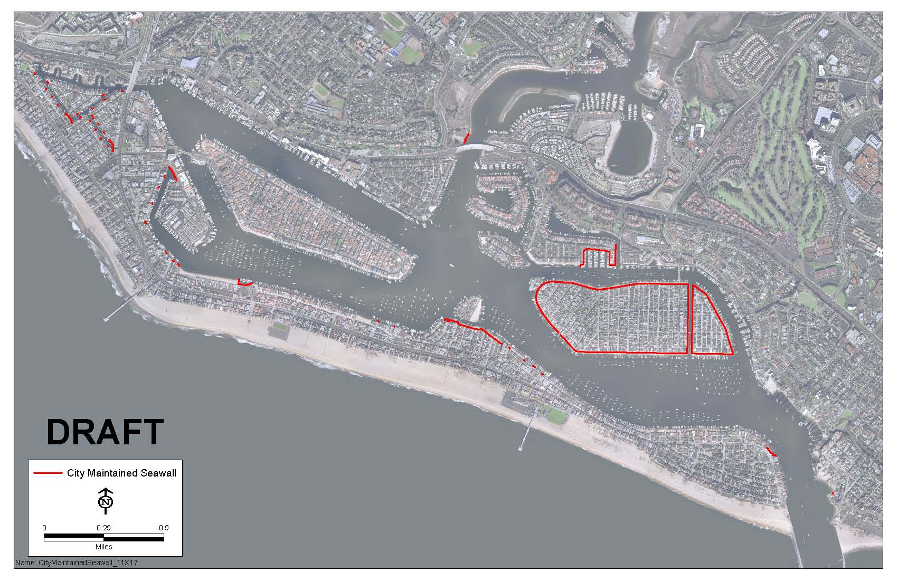
City-Owned Seawalls

Slide 8
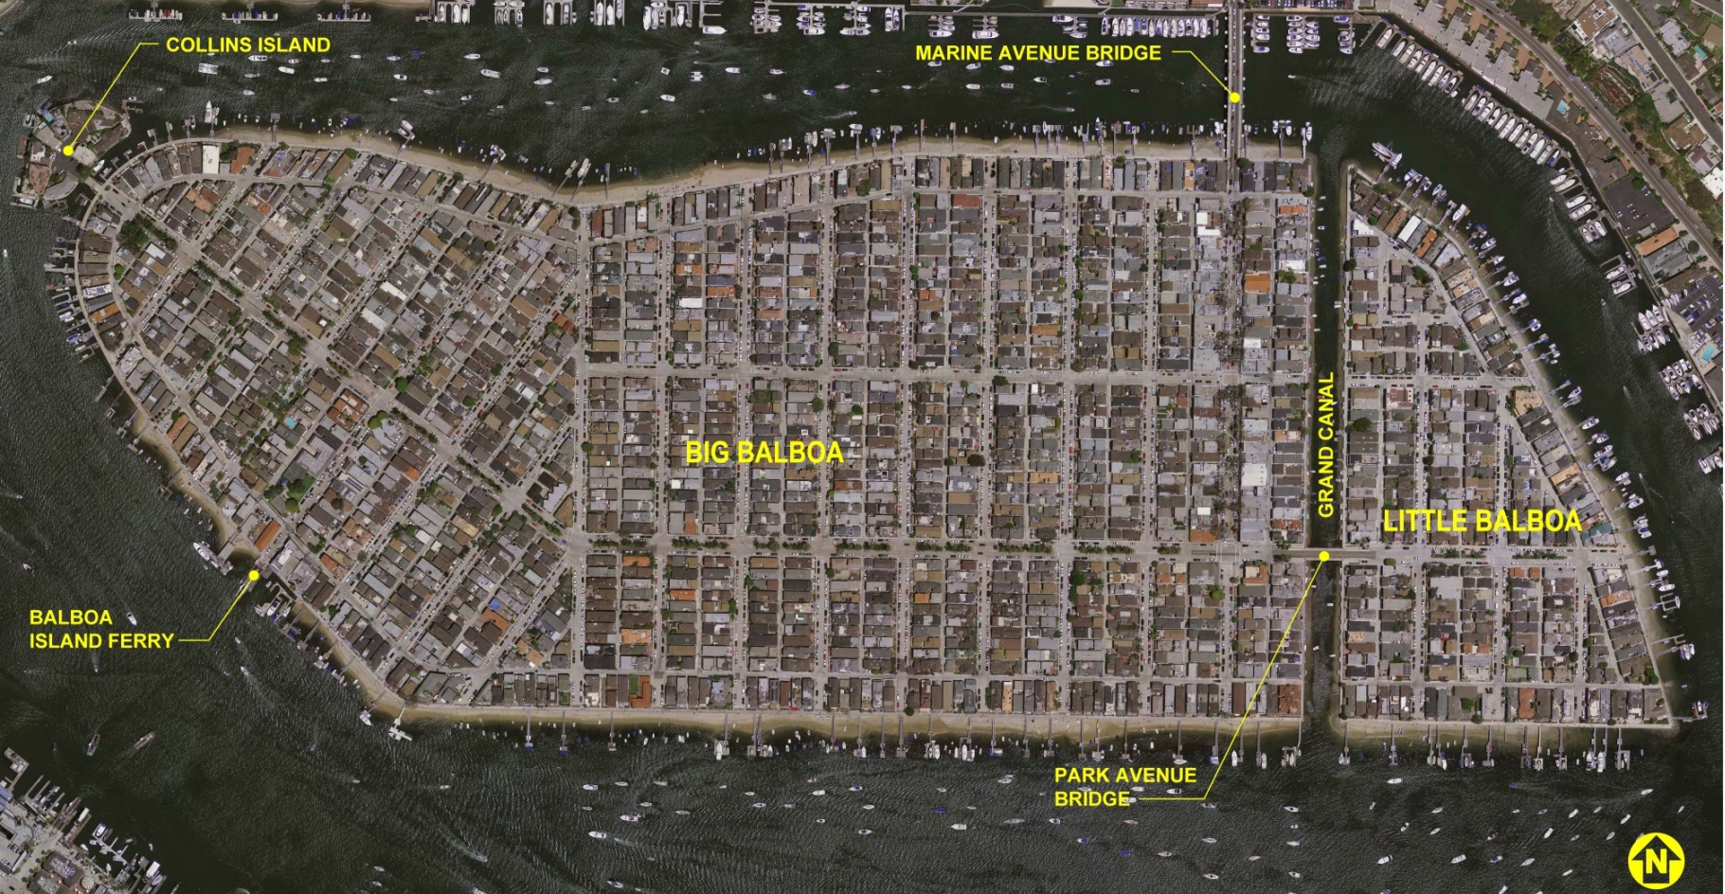
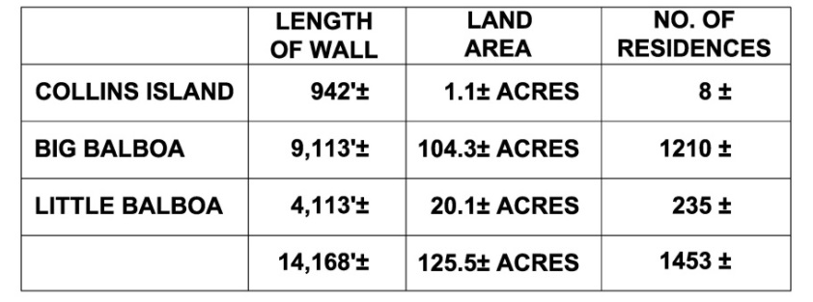
Project Site Overview
West
End

Slide 9
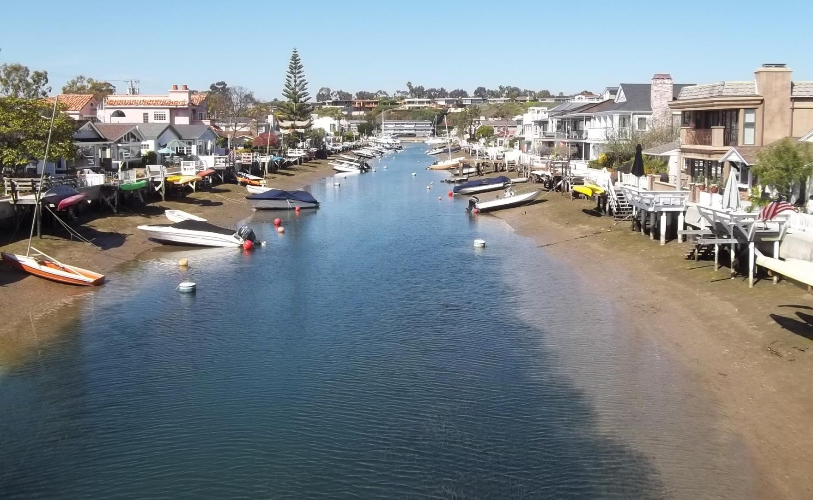
Grand Canal

Slide 10
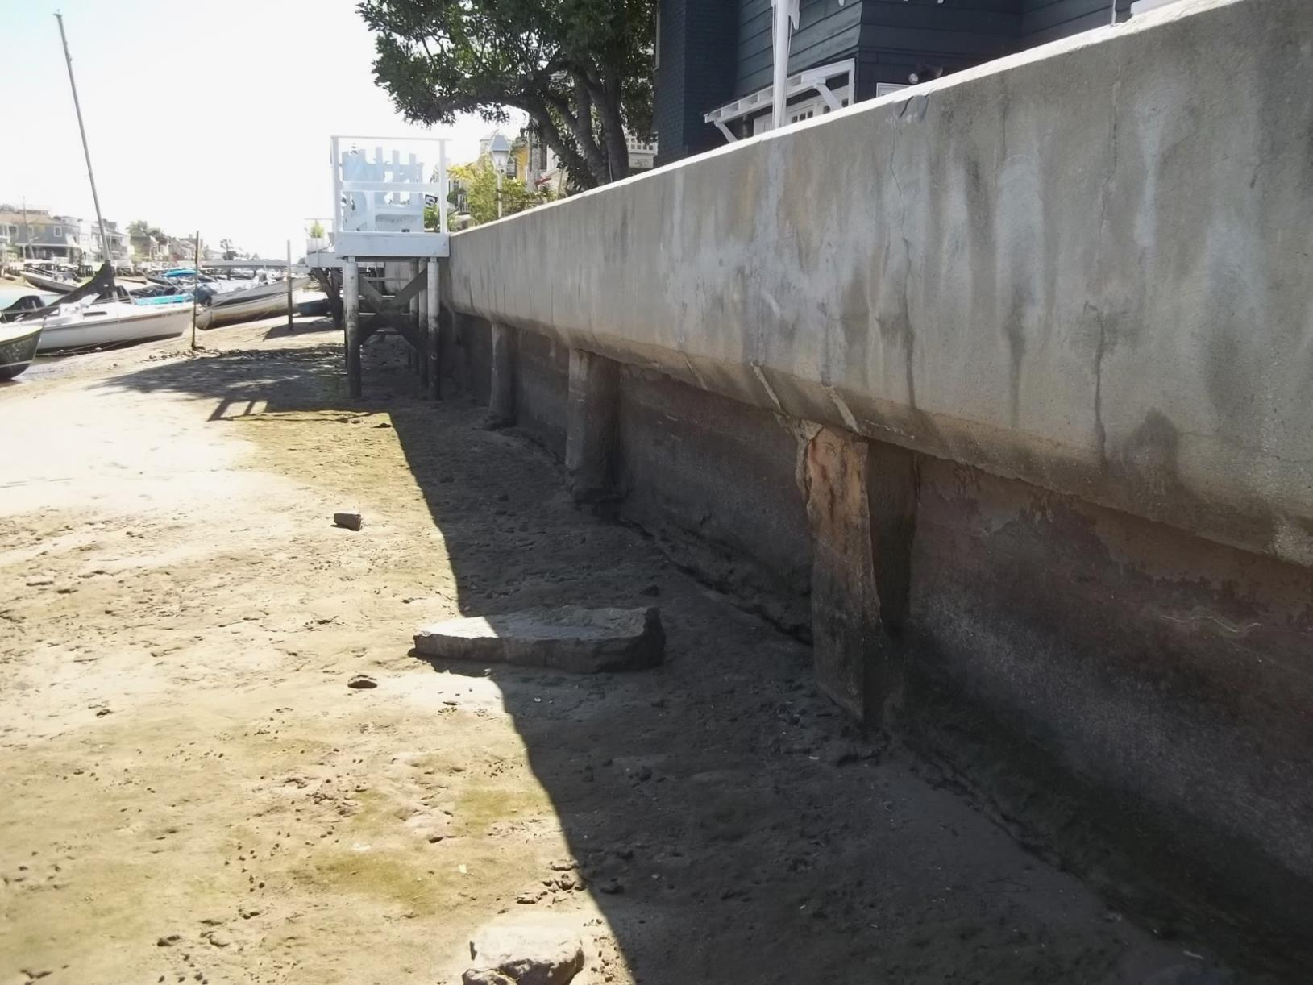
Grand Canal

Slide 11
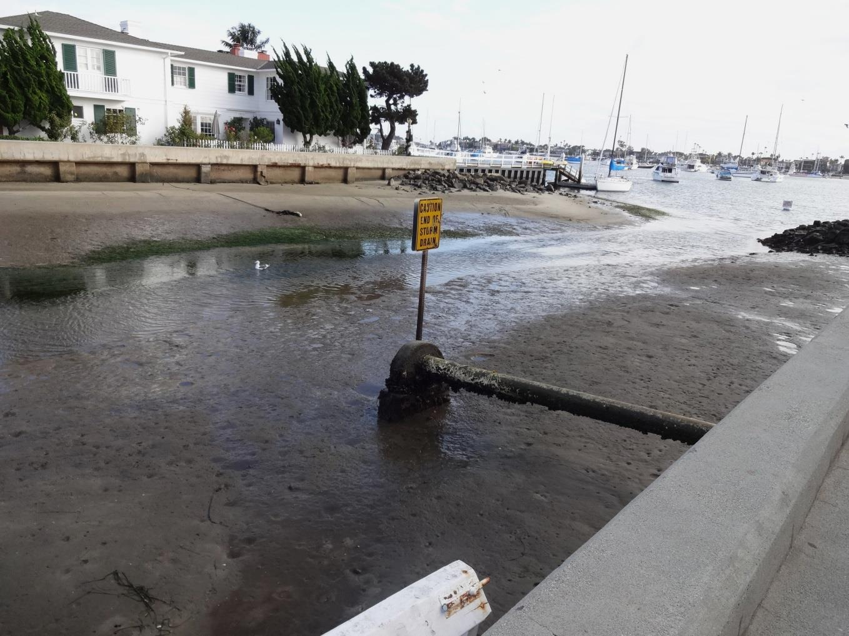
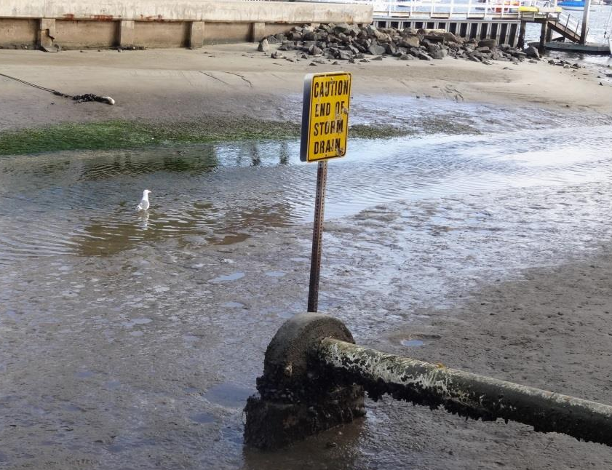
Grand Canal

Slide 12
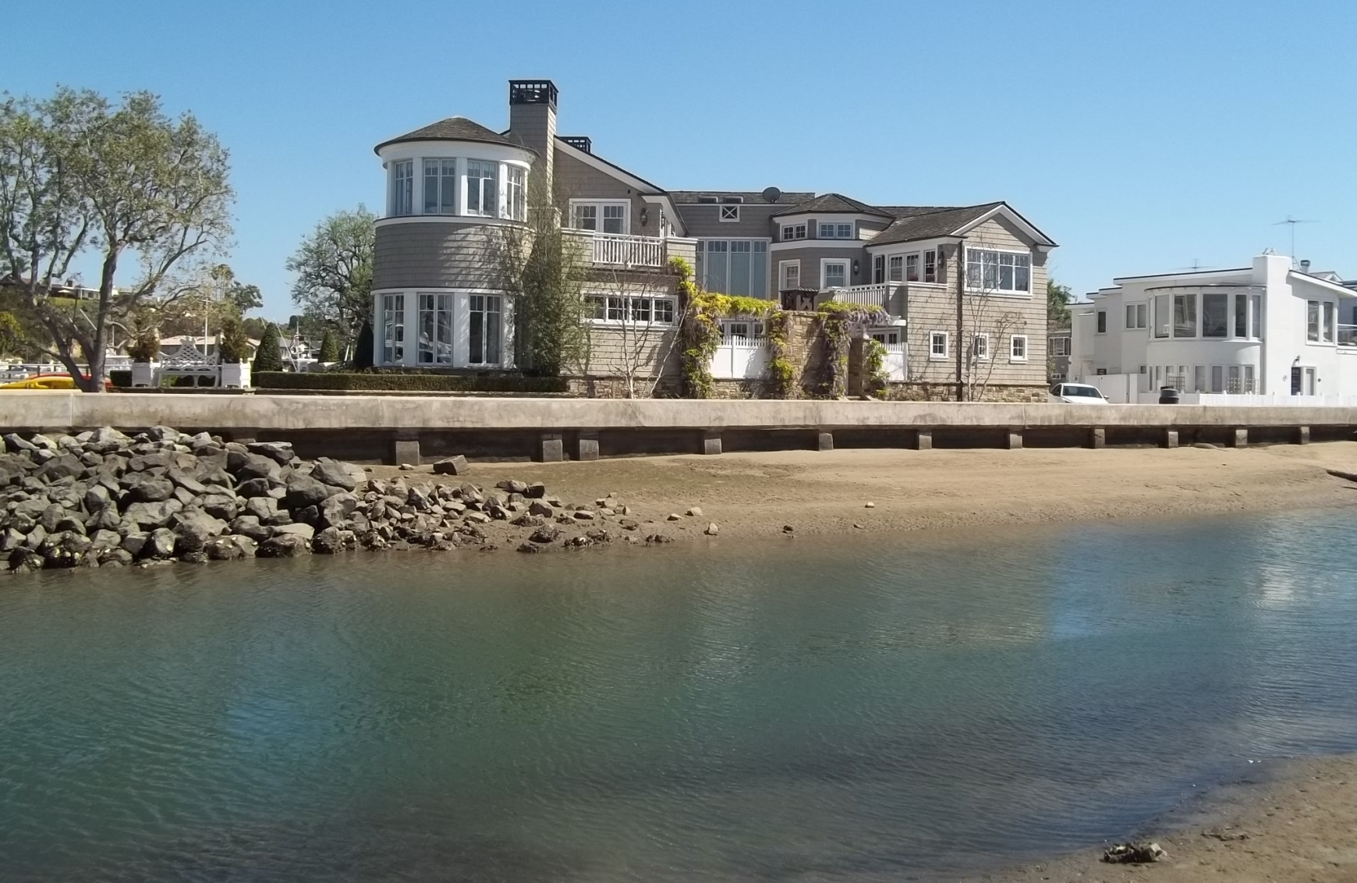
Little Balboa Island

Slide 13
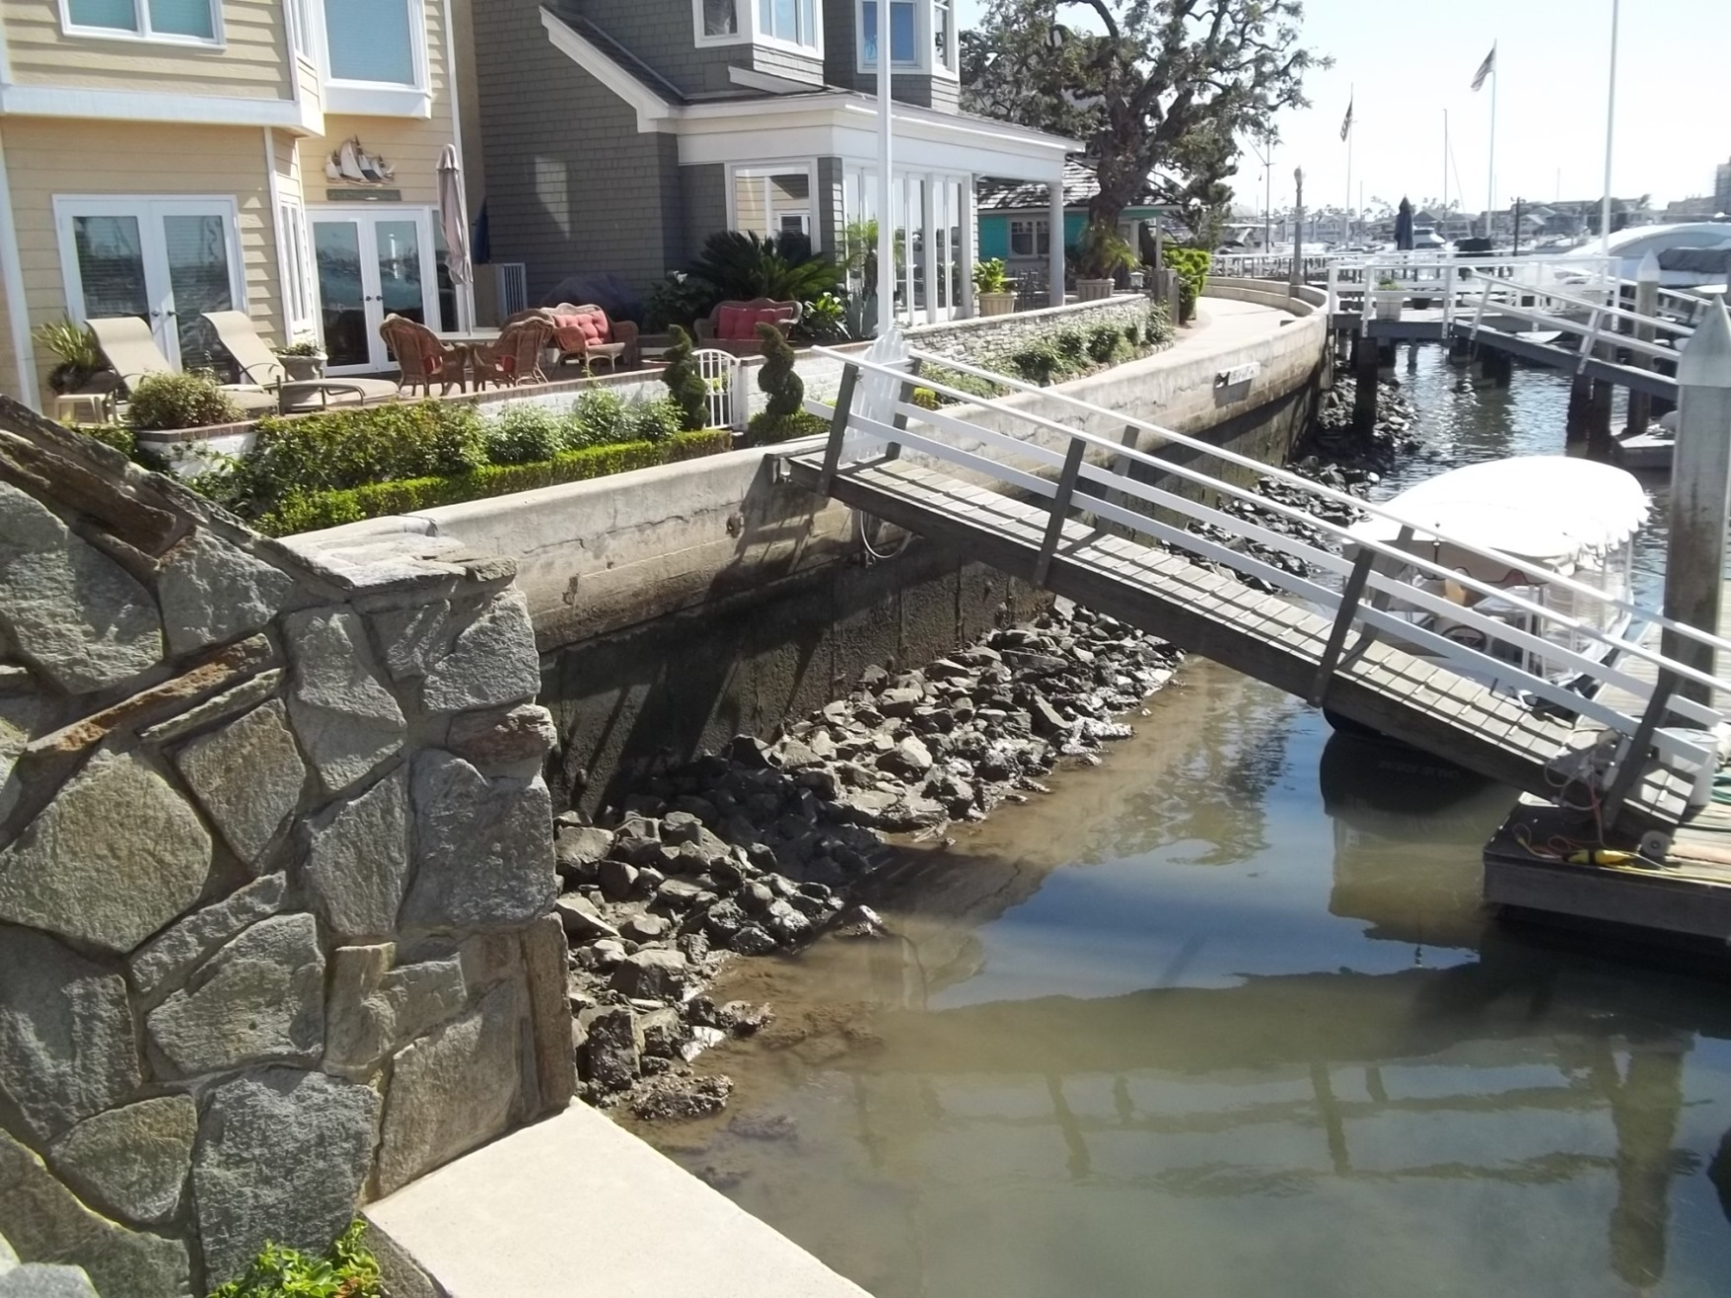
Balboa Island – West End

Slide 14
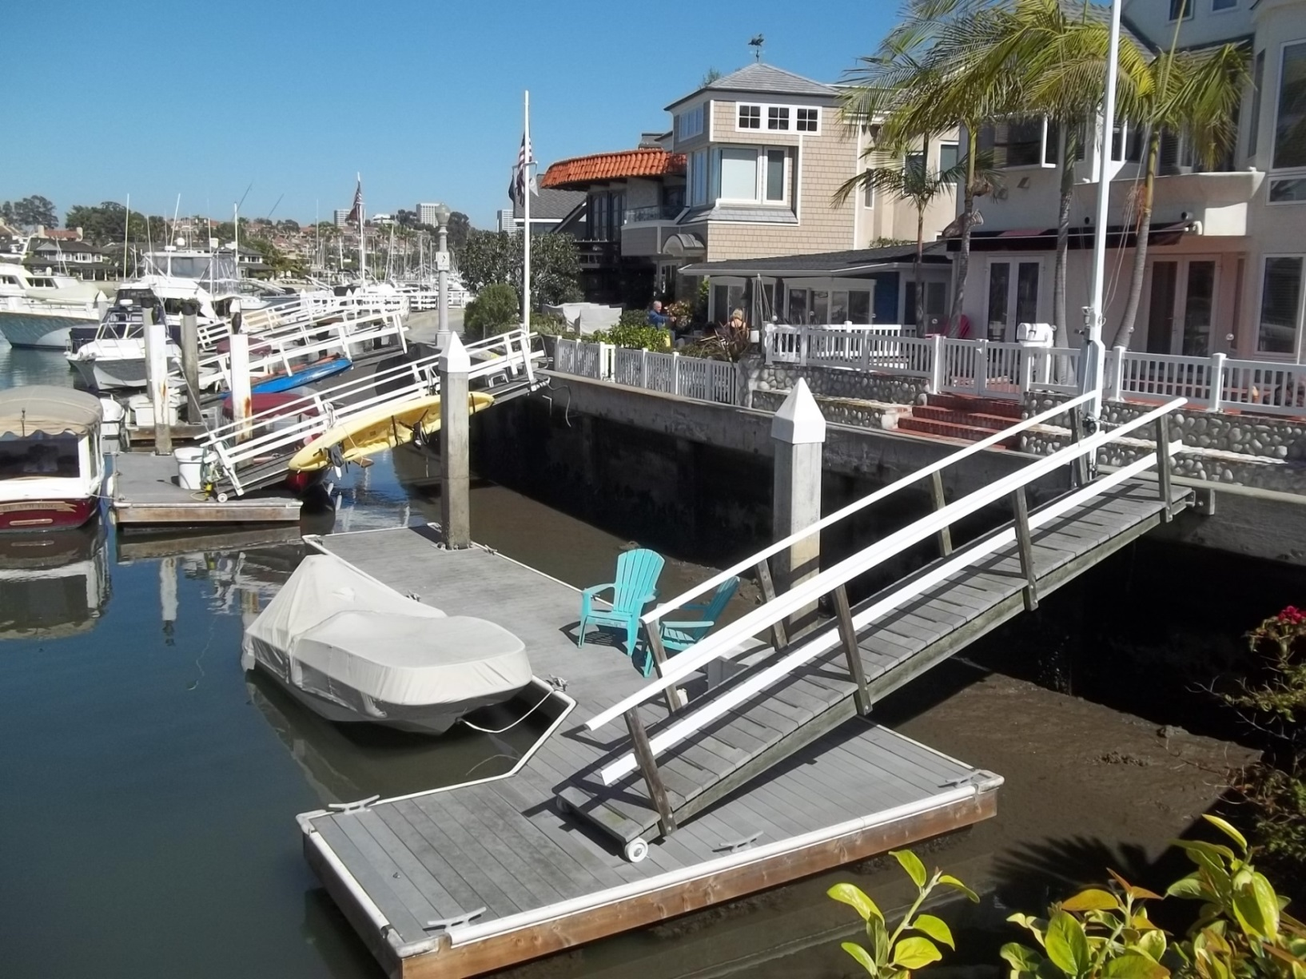
Balboa Island – Typical Floating Dock

Slide 15
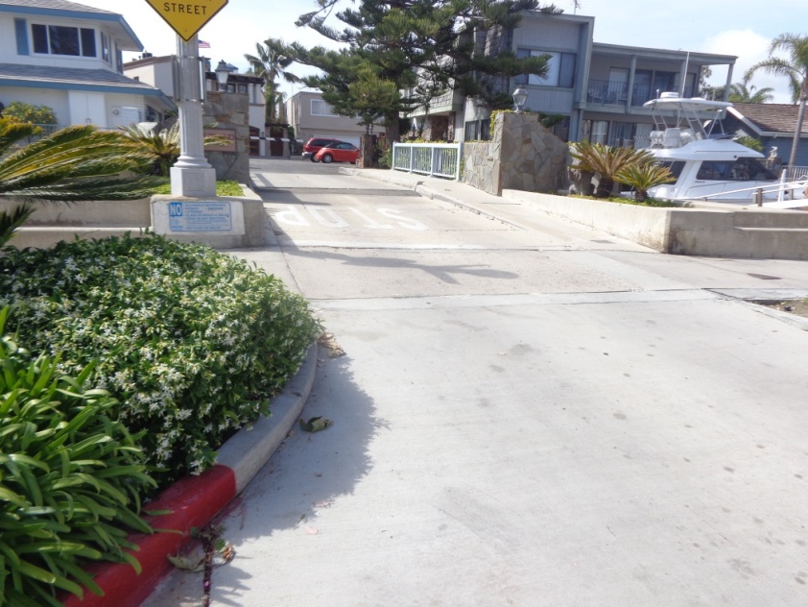
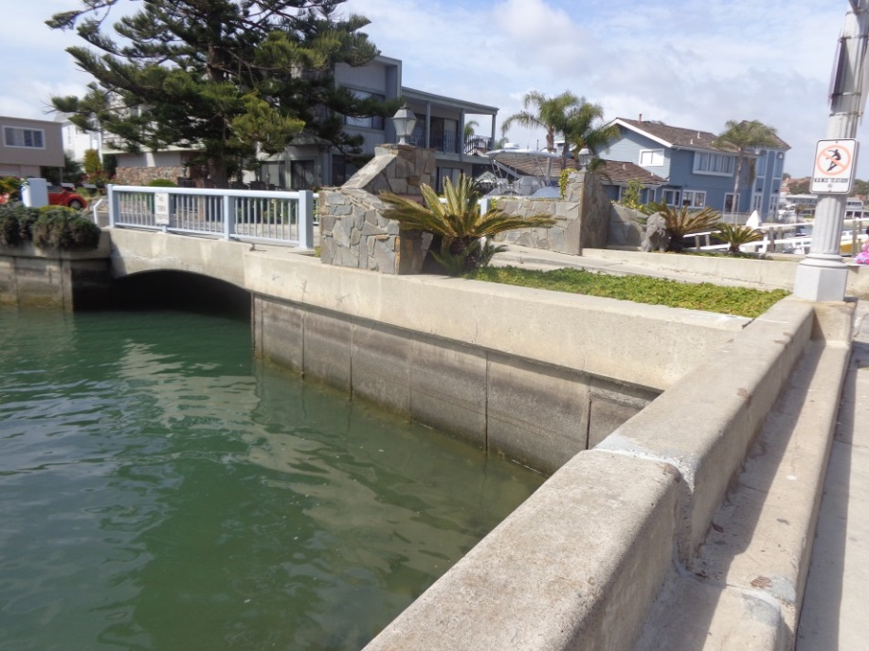
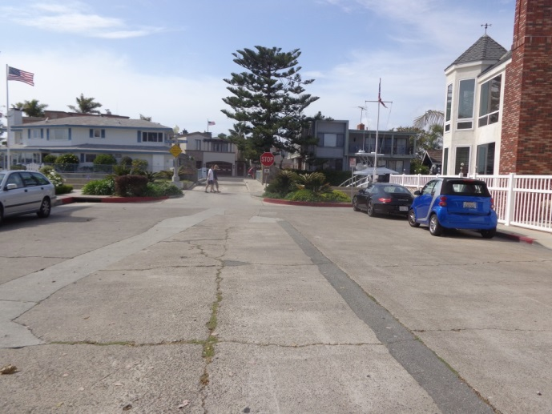
Collins Island (Private)

Slide 16
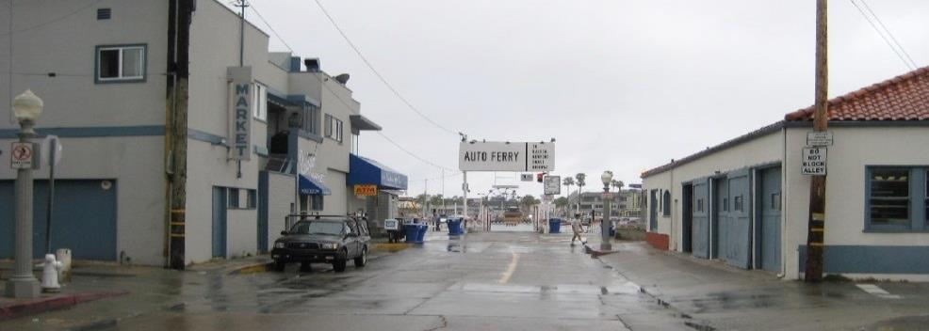
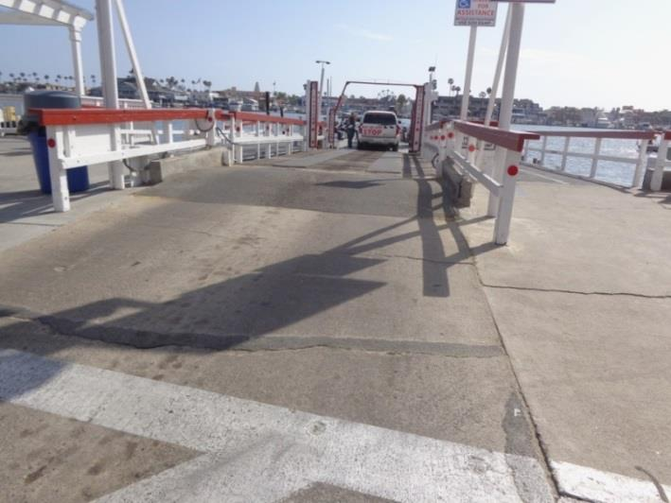
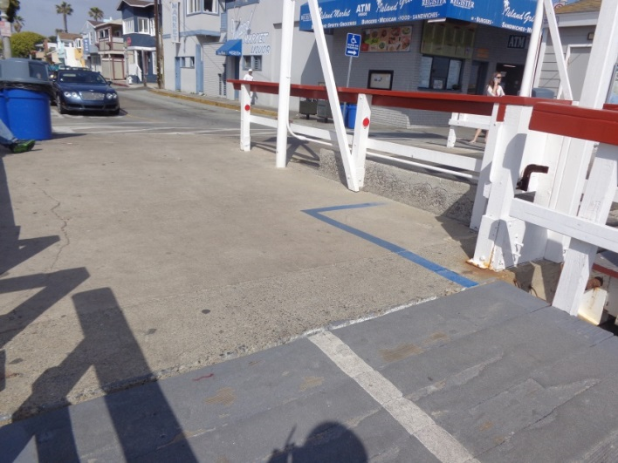
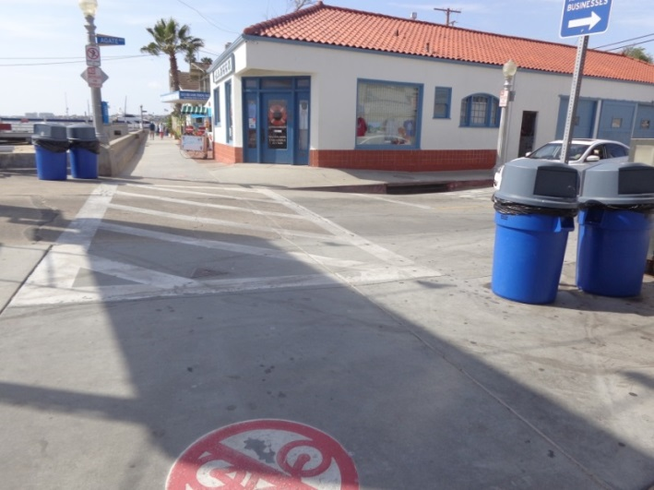
Historic Ferry Boat Landing

Slide 17
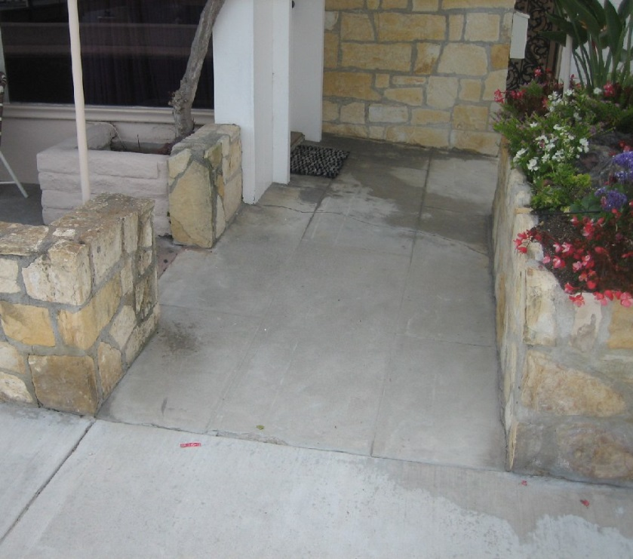
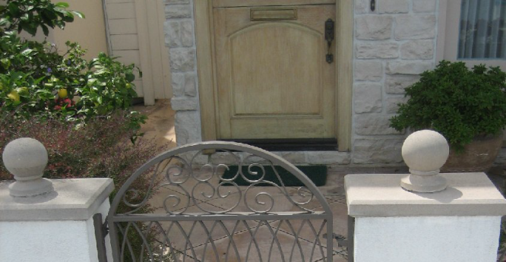
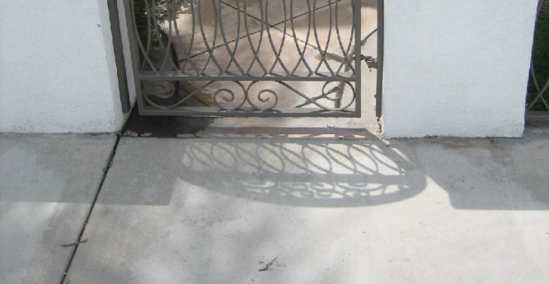
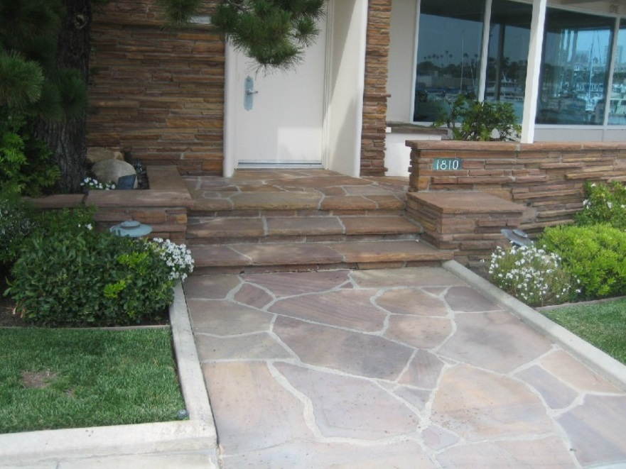
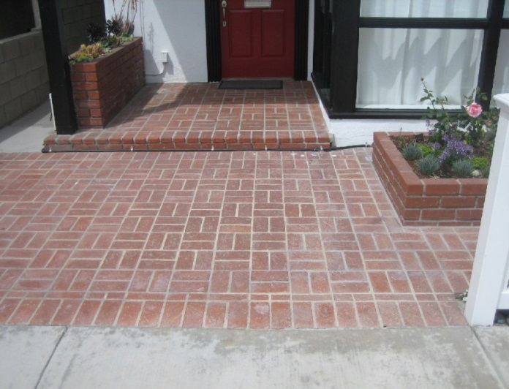
Residential Interface

Slide 18
Existing Conditions

Slide 19
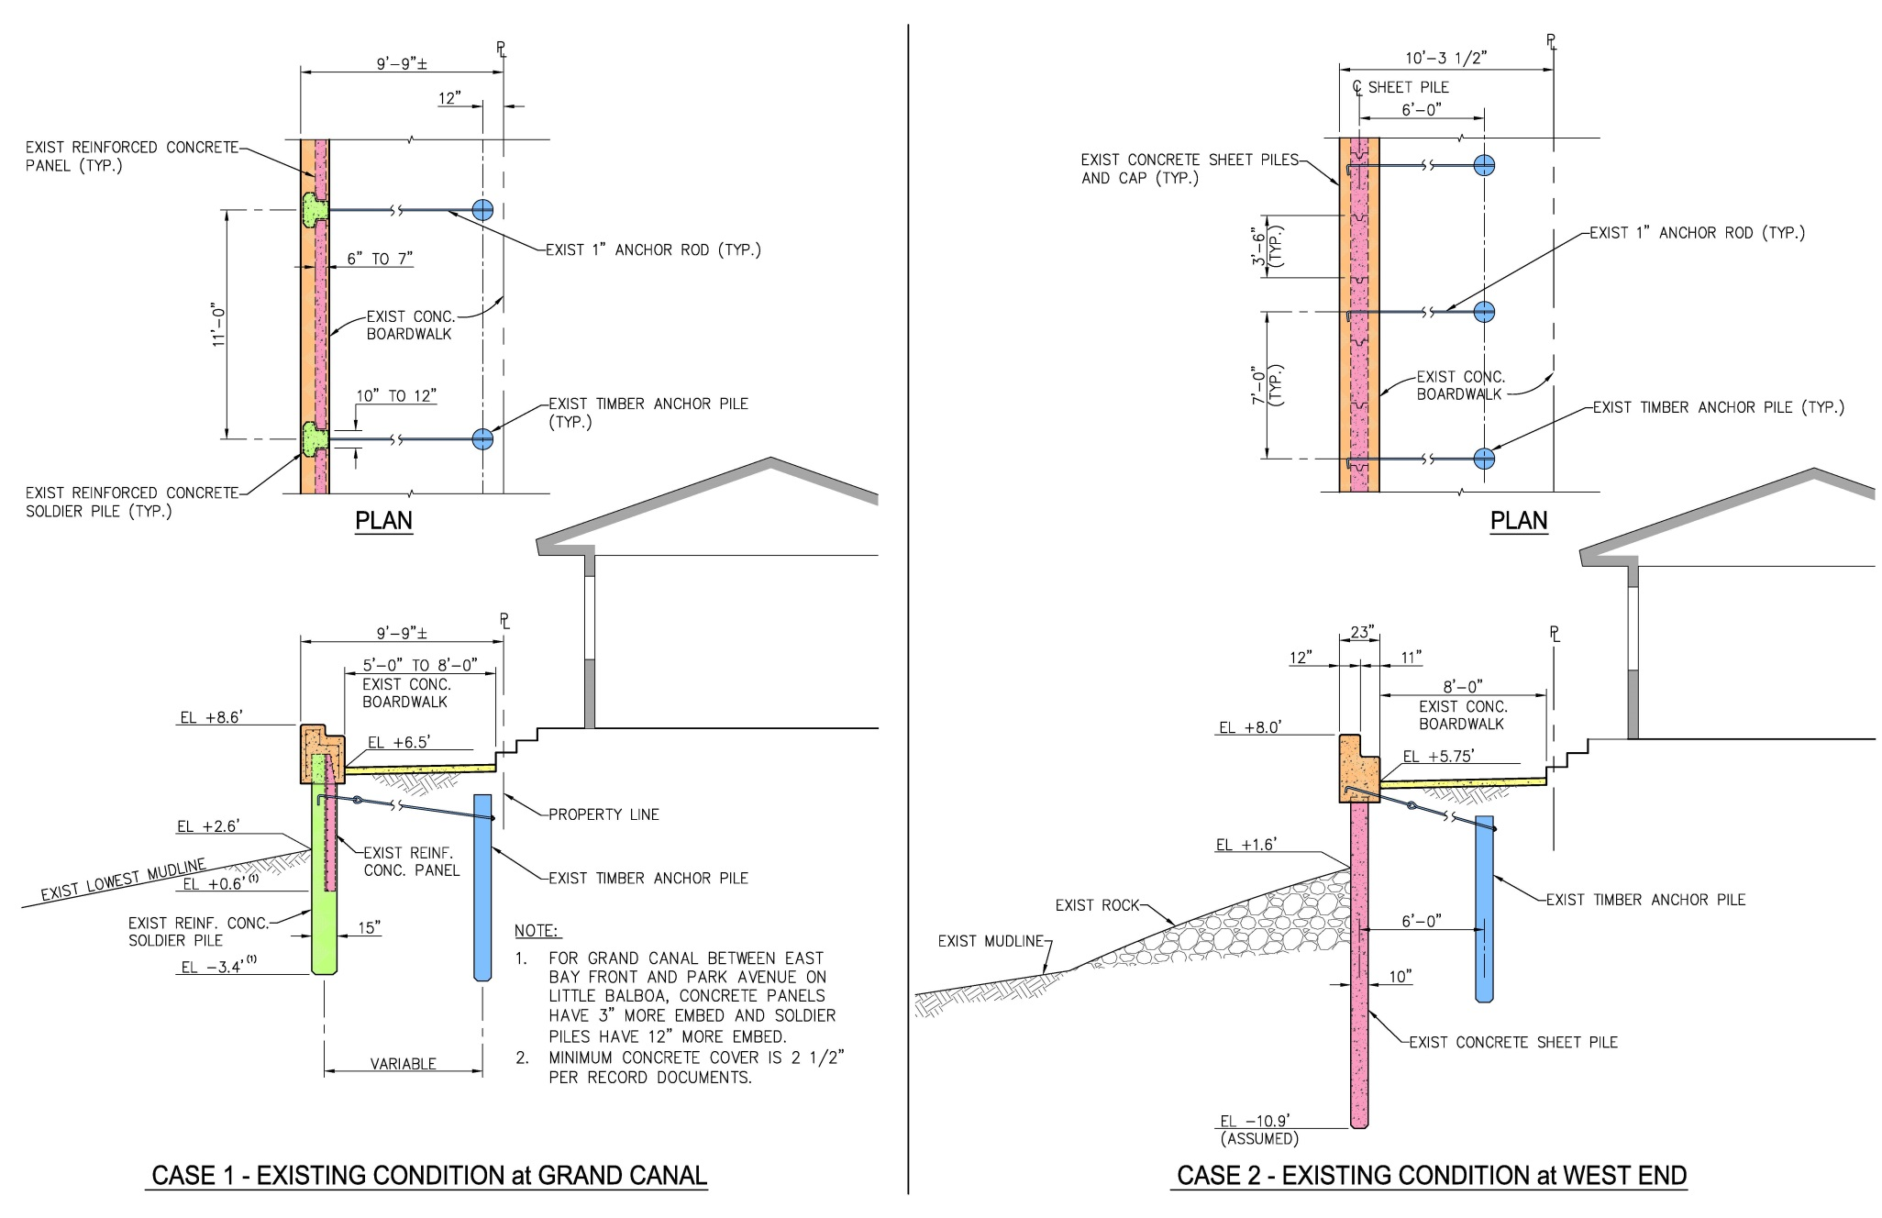
As-Built Conditions

Slide 20

Ballast placed at West End in 1985 - to Prevent Scour

Slide 21
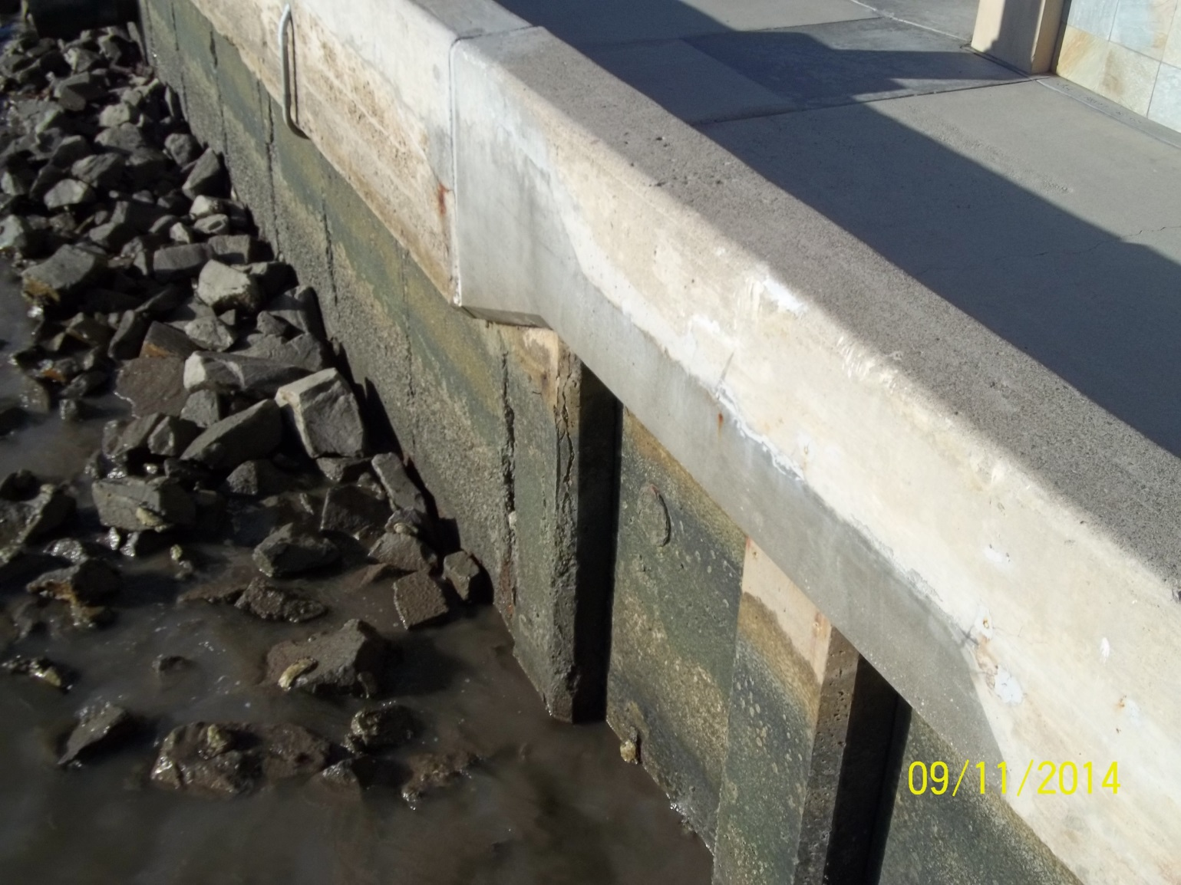
Pile Crack (West End)

Slide 22
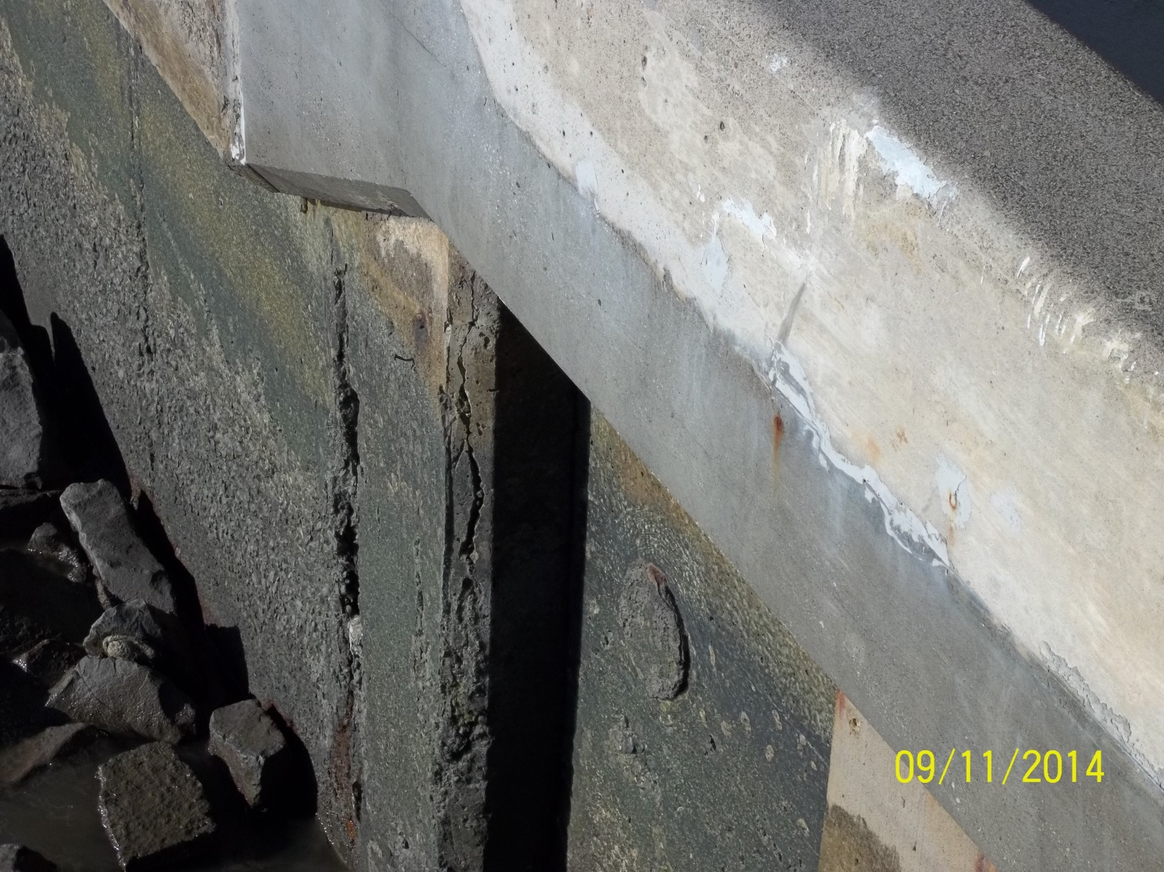
Pile Crack (Close-up)

Slide 23
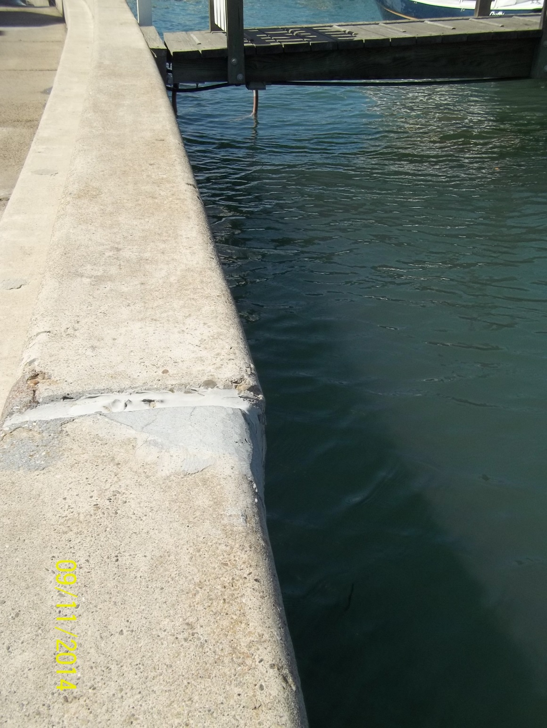
Wall Movement (West End)

Slide 24
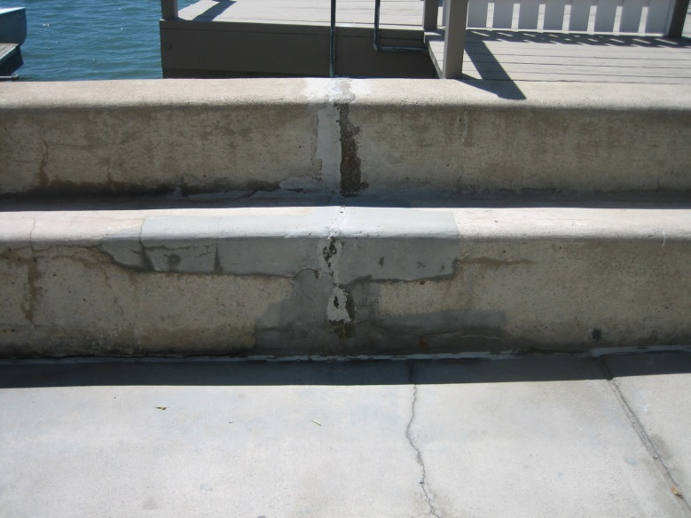
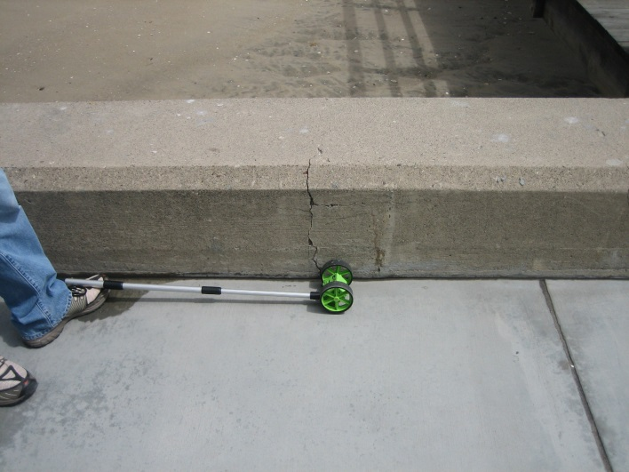
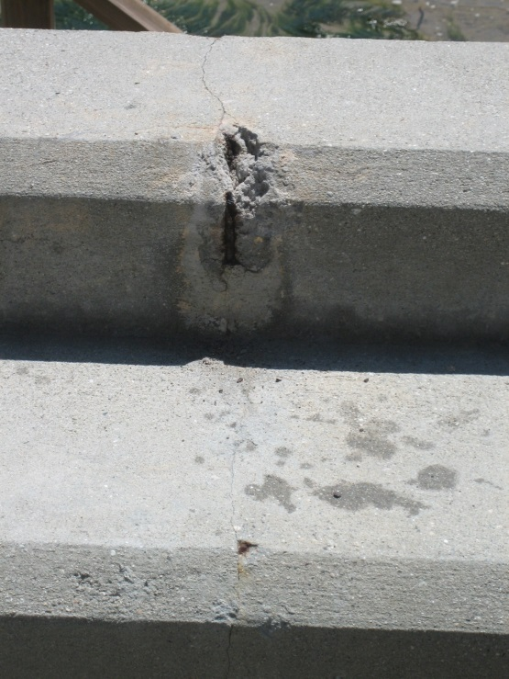
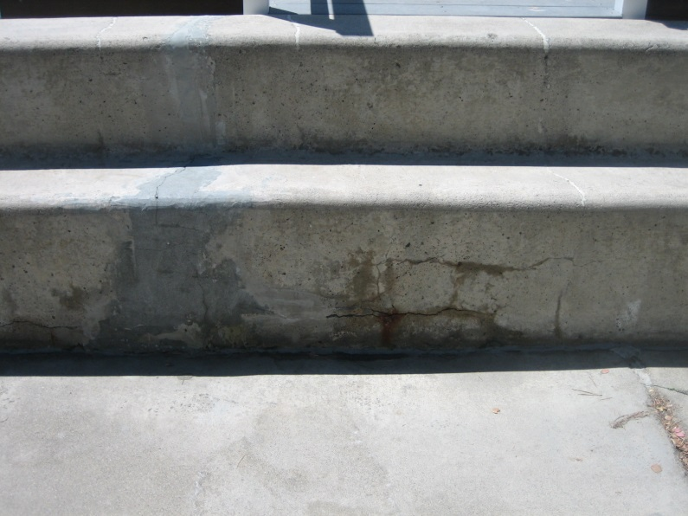
Condition Survey

Slide 25
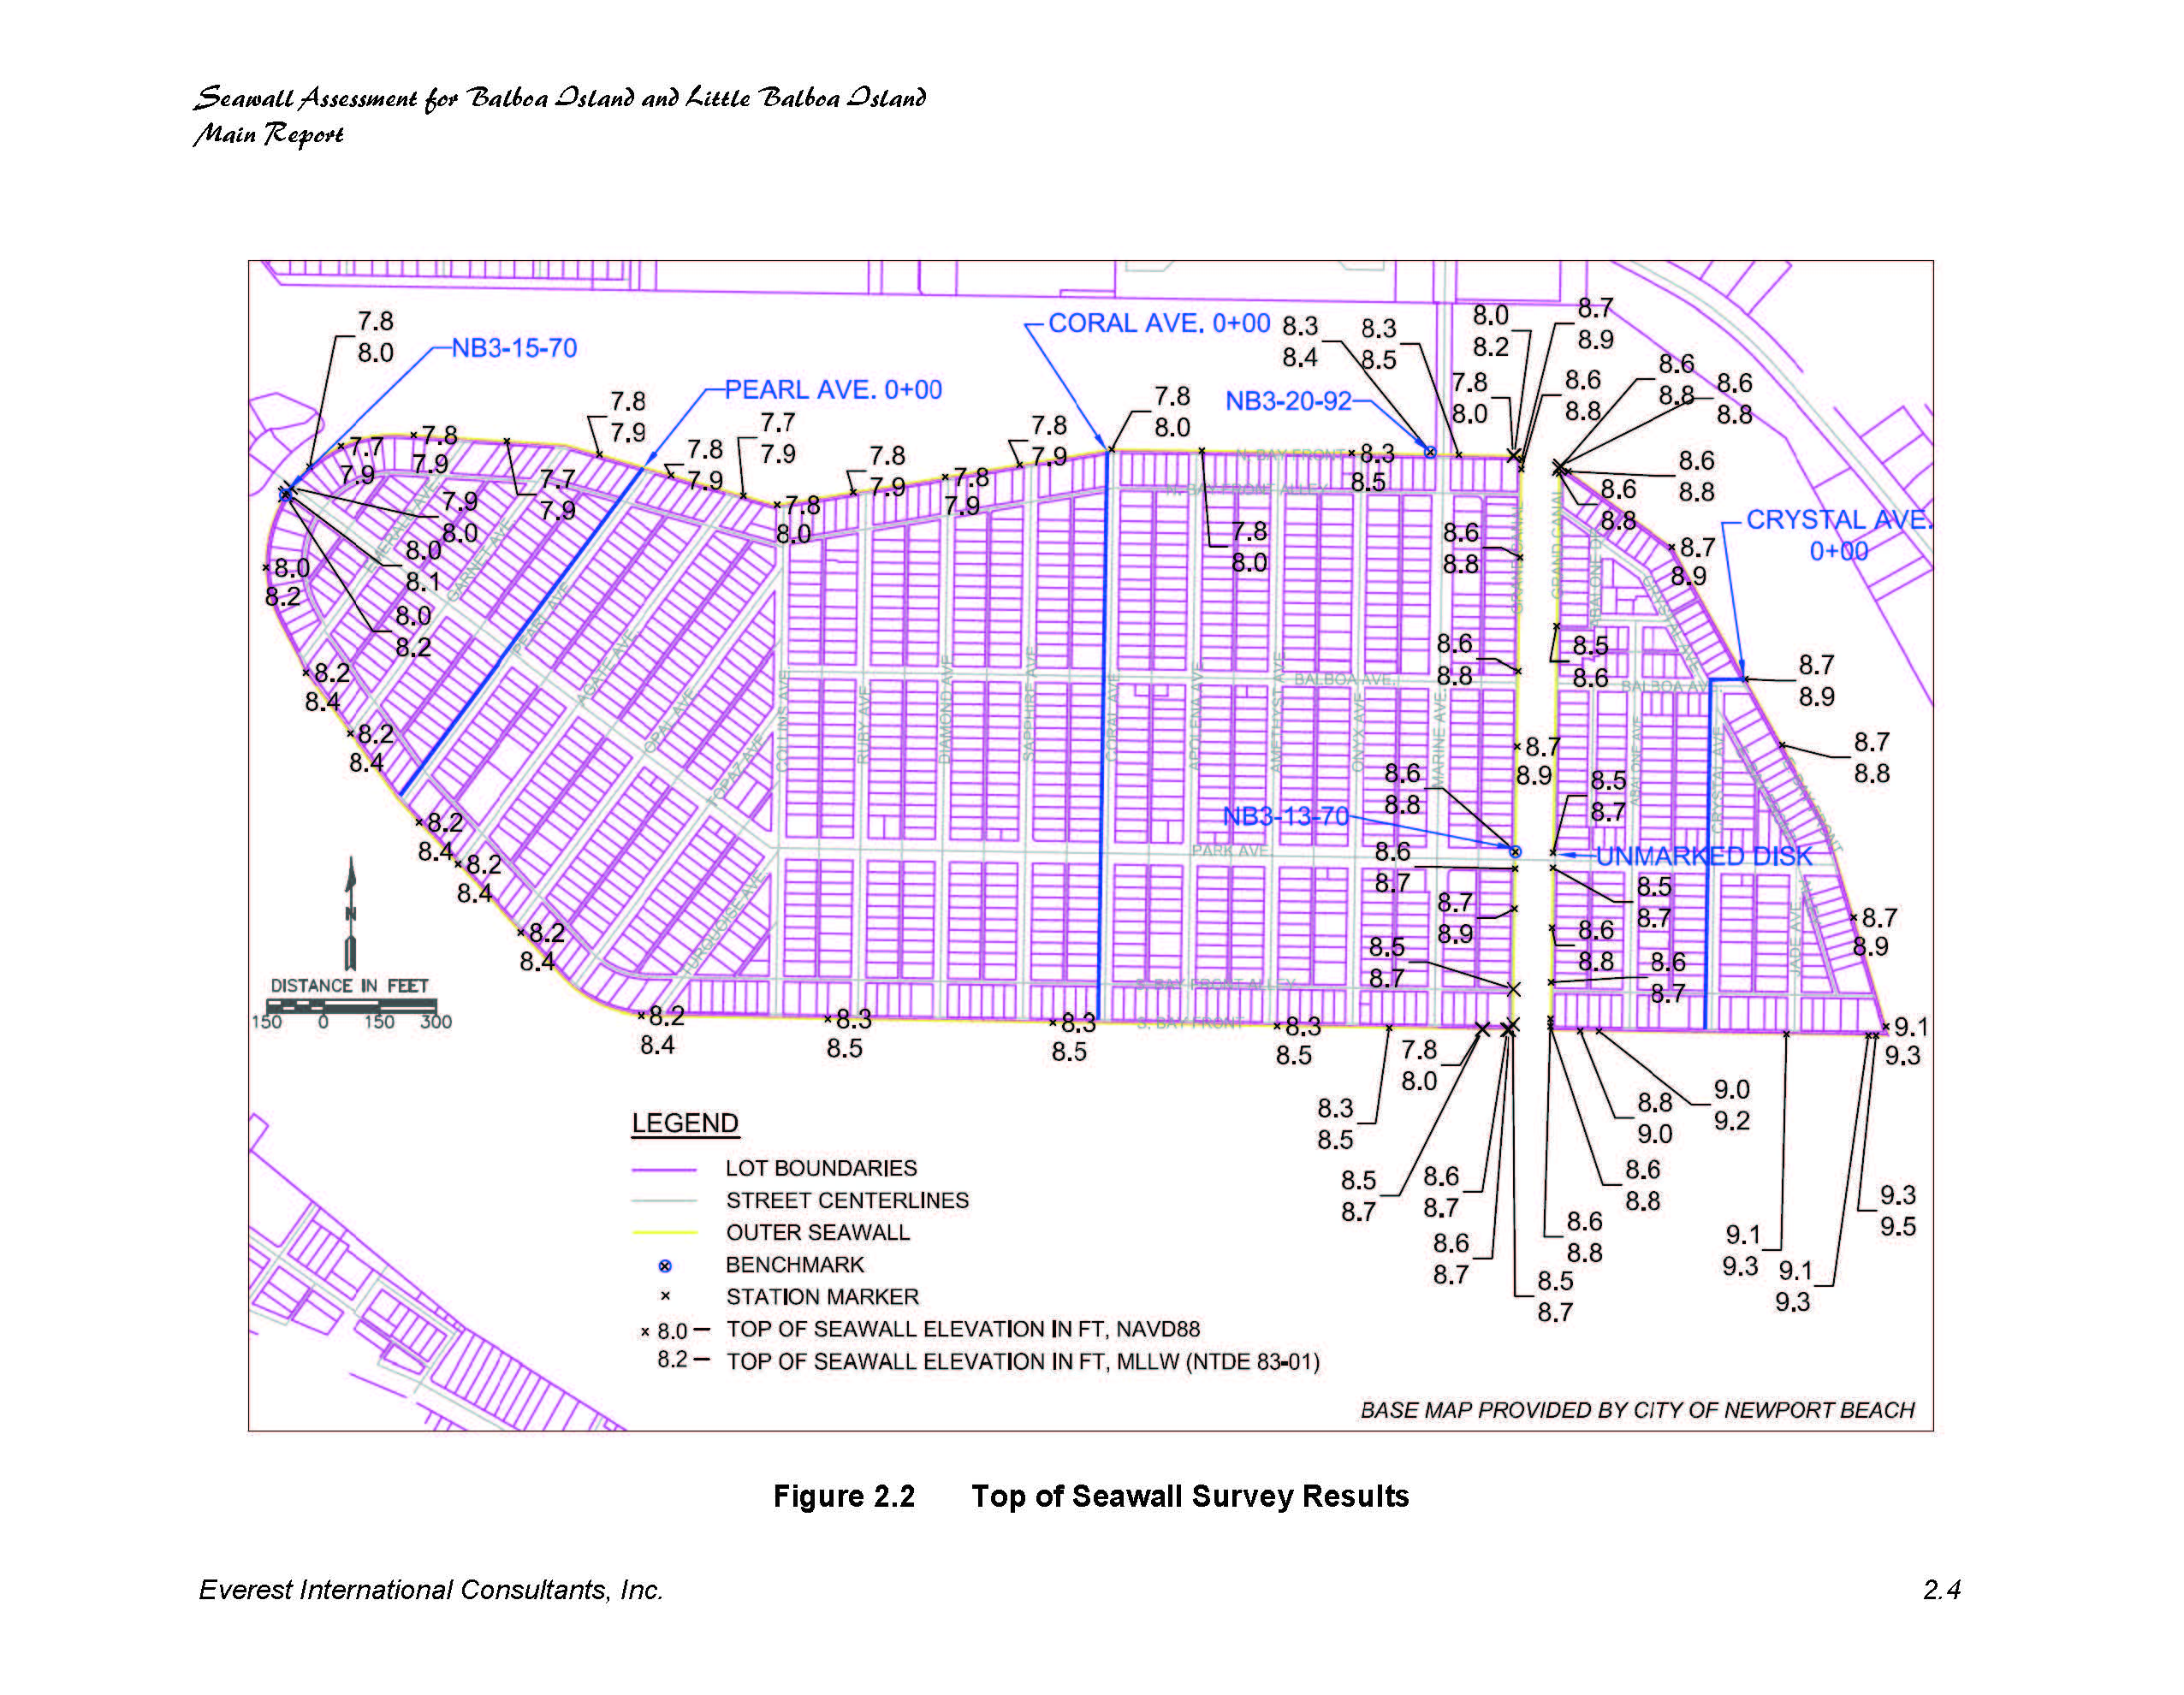

Slide 26
Balboa Islands Seawalls – Condition Summary
85 year old walls. (Original lifespan approximately 75 years. )
Walls are exhibiting obvious signs of deterioration and stress.
Existing walls subject to seismic risk.
Grand Canal: Depth of wall below mudline is very shallow.
Many unknowns: seawall rebar, sheetpile condition below mudline, tiebacks.
Useful lifetime: 10-25 years (2011 report)

Slide 27
Flood Potential

Slide 28
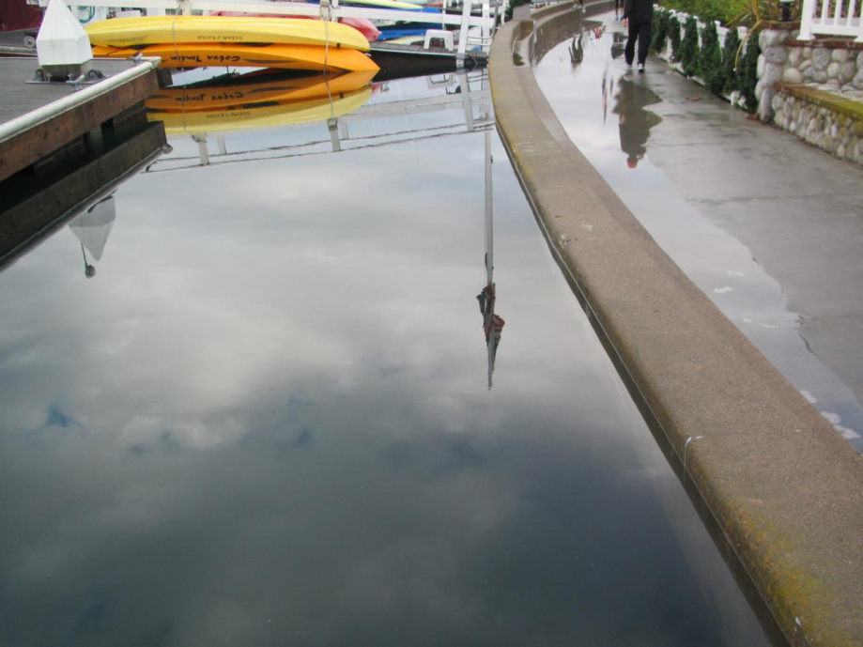
West End Balboa Island, King Tide, 12/12/2013

Slide 29
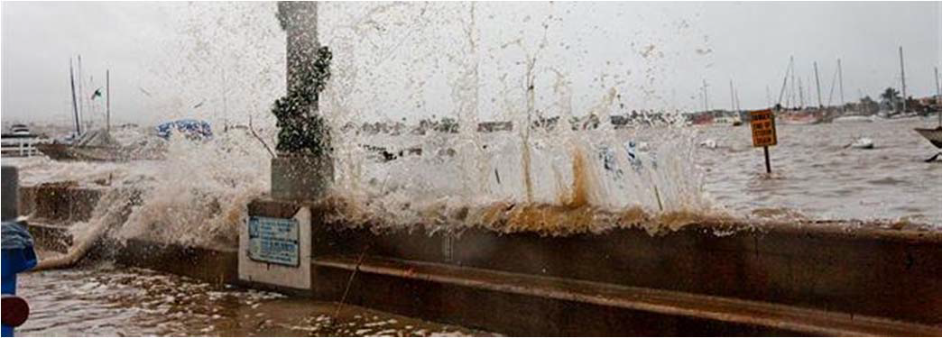
Wave Overtopping During Storm Event

Slide 30
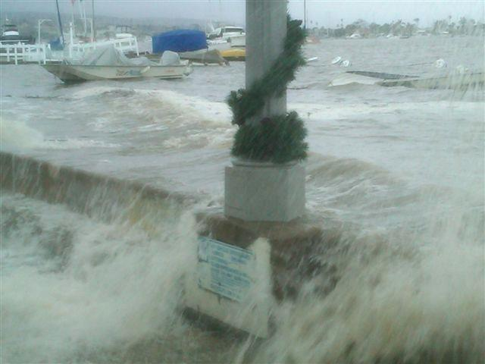
Overtopping Due To Storm Surge

Slide 31
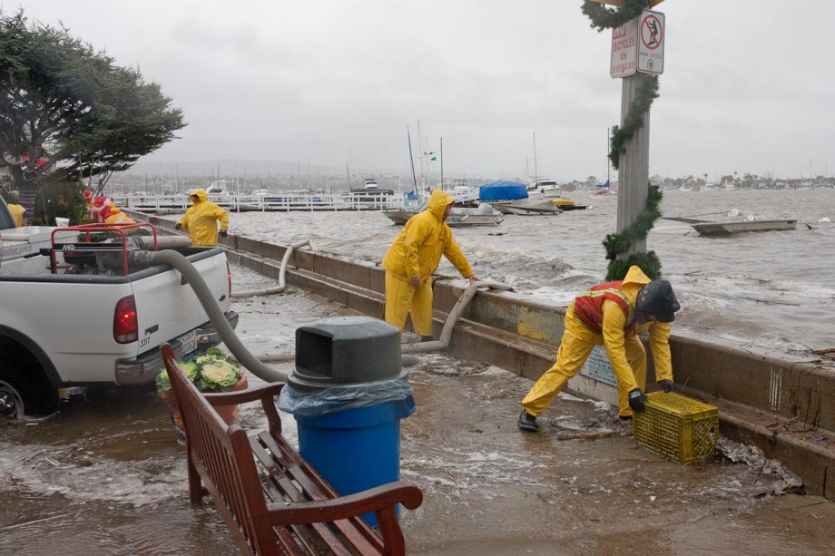
City Emergency Response
Public Works staff mobilize emergency pump stations throughout the City.

Slide 32
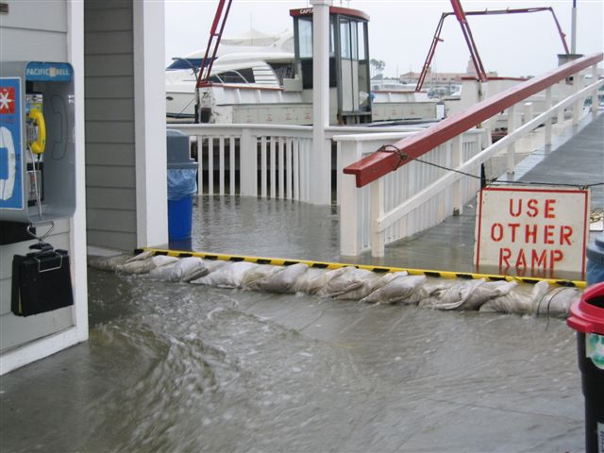
Flooding at Balboa Island Ferry Landing (2005)

Slide 33
Sea Level Rise Predictions – 2100 The 95% column on the right side indicates that there is a 5% chance the predicted sea level rise will be exceeded.
Agency | Year | 5% | 50% | 95% (high confidence)
IPCC 4th Assessment | 2007 | 9” | 15” | 20”
Vermeer and Rahmstorf | 2009 | 39” | 49” | 61”
US Corps of Engineers | 2011 | 17” | 39” | 59”
National Academy of Sciences (& California Coastal Commission) | 2012 | 17” | 37” | 66”
IPCC 5th Assessment | 2013 | 17” | 24” | 31”
Quaternary Science Reviews | 2014 | 28” | 37” | 47”
California State Coastal Conservancy in 2009 adopts Climate Change Policy of 55-inch sea level rise by 2100.

Slide 34
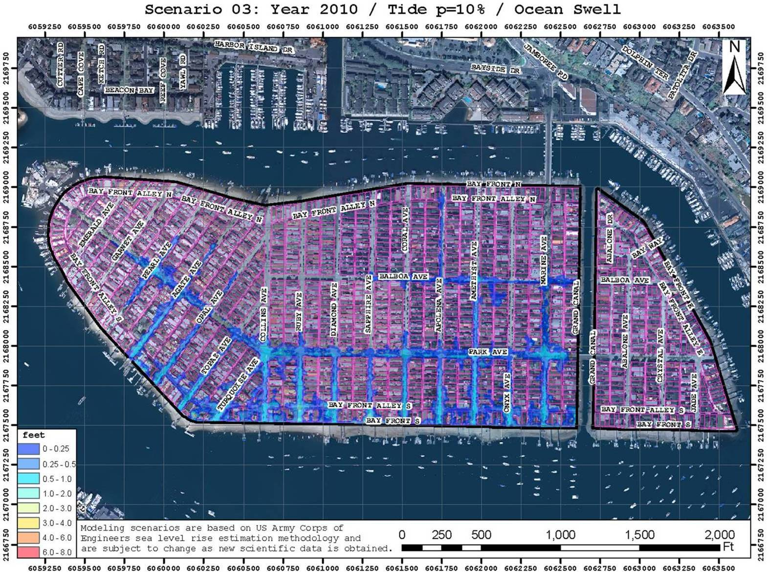
2010 Flood Scenario 3: Ocean Swell

Slide 35
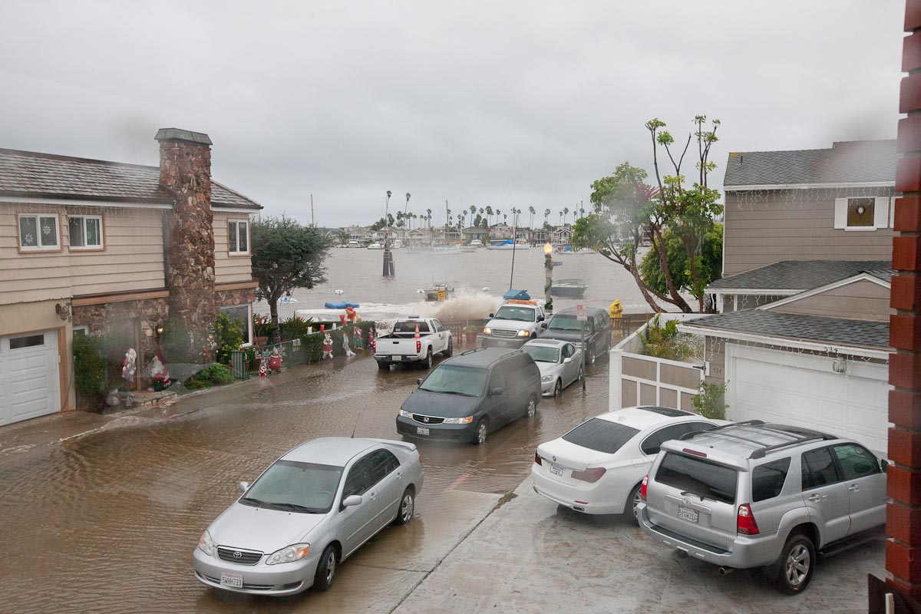
December 2010 Flooding on Turquoise - Extreme Tide p=40% w/ Ocean Swell

Slide 36
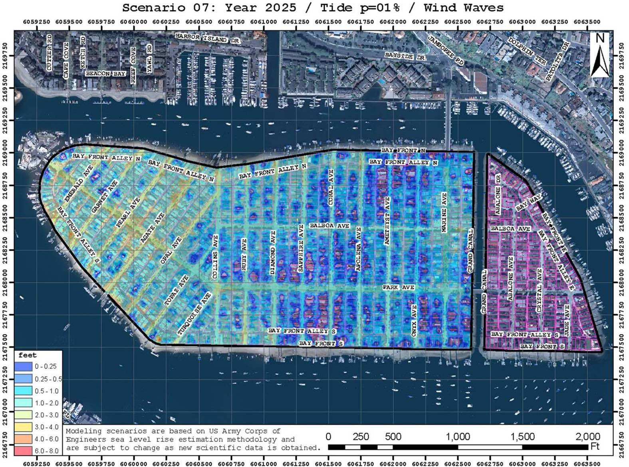
Existing Seawall, Year 2025, 1% Tide, Wind Waves

Slide 37
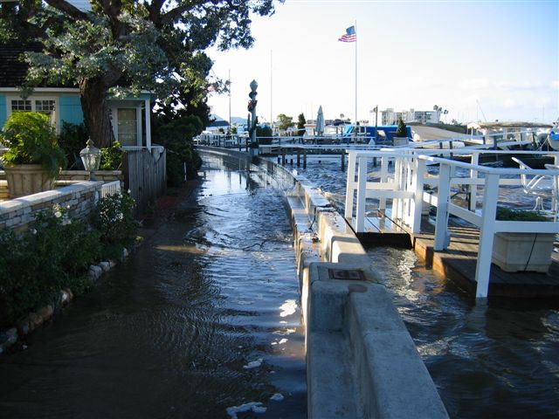
Wind Waves at High Tide

Slide 38
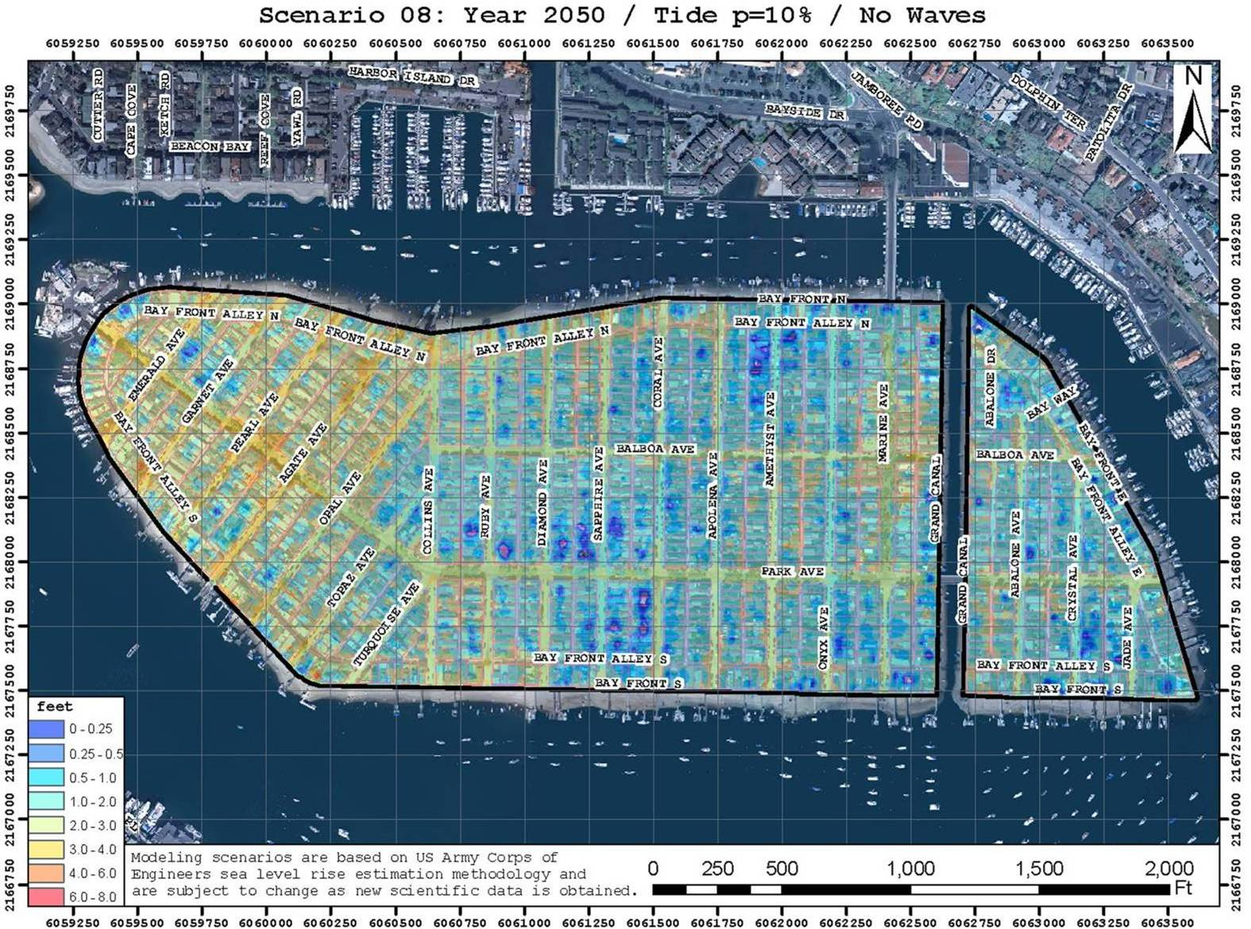
Existing Seawall, Year 2050, 10% Tide, No Waves

Slide 39
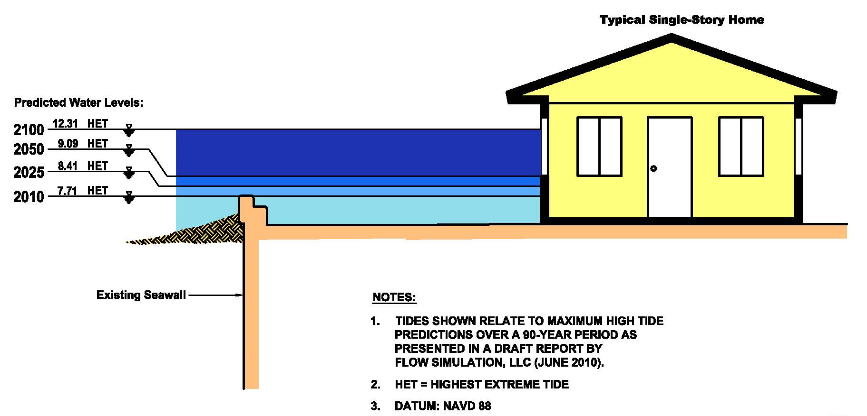
Extreme Tide Height Projections

Slide 40
Seawall Replacement and Rehabilitation

Slide 41
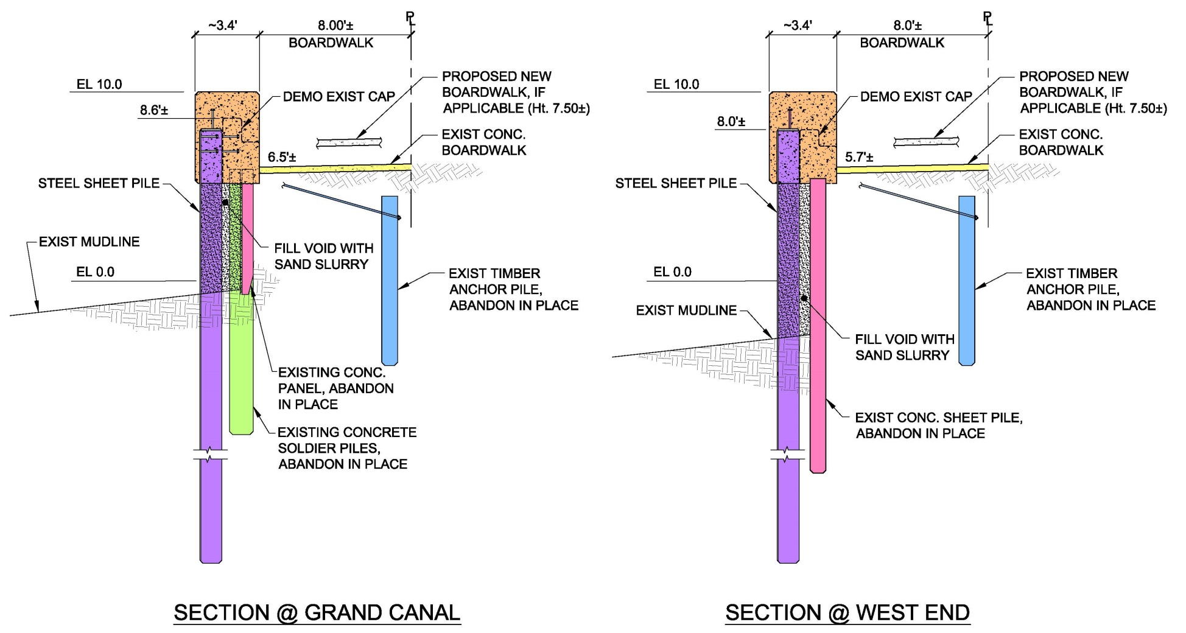
Proposed New Seawall Concept
Elevation Datum: NAVD88

Slide 42
Increase Top of Wall Elevation → Provides flood protection until 2025
LOCATION Now New Difference
Balboa Island N. 7.8’ 8.5’ +8.4 inches
Balboa Island S. 8.25’ 9.0’ +9 inches
Grand Canal 8.5’ 8.5’
Little Island E. 8.7’ 8.7’
Little Island S. 9.0’ 9.0’
* all elevations based on NAVD88 datum.

Slide 43
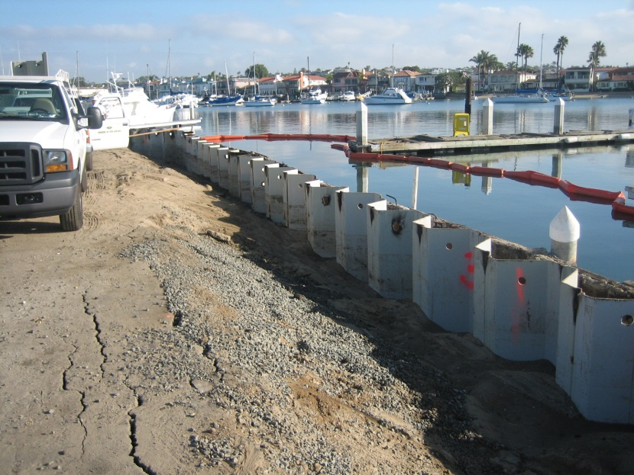



Steel Sheet Piles (Silent Pile Driver)

Slide 44

Bay Island: Steel Sheet Piles and Cap

Slide 45

Bay Island Sheet Piles and Cap

Slide 46

Similar Installation - Naples Island, Long Beach, CA

Slide 47
Projected Cost – Option A
Rehabilitation Option | Seawall Useful Lifetime | Initial Cost
Option A: All New Seawalls | 100 years | $70 million
Notes:
25% Contingency
Cantilevered wall designed to take extension up to Elevation 14.0.
Costs includes seawalls, caps, pier and beach access ramps, modifications to entrances at Historic Ferry Landing and Collins Islands, and ADA modifications to the boardwalk near Mariner’s Bridge.
Seawall costs are based on 2014 bids for new seawalls for Naples Island, Long Beach.
Costs shown in today’s dollars.
Elevation Datum: NAVD88

Slide 48

Option B: new Seawalls at West End and Grand Canal. Cap the other walls.

Slide 49
PROPOSED 9-INCH CAP EXTENSION

Slide 50

Example: Little Balboa Seawall Cap Extension

Slide 51
Projected Costs – Options A & B
Rehabilitation Option | Seawall Useful Lifetime | Initial Cost
Option A All New Seawalls (Initial Top Elevation: 10 feet) | 100 years Raise walls after ~2060 if needed | $70 million
Option B New Seawalls along West End and Grand Canal only Cap Remaining | 100 years 20-25 years then replace capped walls | $32million (> $45 million)

Slide 52

Earth Anchor and Waler

Slide 53

Earth Anchors at Balboa Island Ferry Landing

Slide 54

Annual Sand Buttressing

Slide 55
Projected Costs: Options A, B & C
Rehabilitation Option | Seawall Useful Lifetime | Initial Cost
Option A All New Seawalls | 100 years | $70 million
Option B New Seawalls along West End and Grand Canal only Cap Remaining | 100 years 20-25 years then replace capped walls | $32 million (>$45 million)
Option C New Seawall along Southwest End Earth Anchors at Northwest End & Grand Canal Cap Remaining | 100 years 20-25 years then replace with new seawalls | $17 million (>$55 million)

Slide 56
Option D – Cap Extensions and seawall rehab only--- $14 million

Slide 57

If sea levels rise about 4 feet, ocean side beaches will need to be raised.

Slide 58
Jetty Gate Alternative

Slide 59
Sea Level Rise Alternative Solution

Slide 60

Conceptual Tide Gate

Slide 61

Conceptual Tide Gate

Slide 62

Conceptual Tide Gate

Slide 63
Tidelands Committee – Recommendations for Future Consideration of Jetty Gate
Confirm magnitude and rate of sea level rise.
Install tide gauge in harbor.
If we truly are experiencing rapid sea level rise of 66 inches by 2100, we should be able to measure a ~2 inches of sea level rise by ~2020.
More expensive analysis can be found on City’s website.

Slide 64
Other Considerations - Access

Slide 65
Access onto Private Dock

Slide 66
Access onto Private Dock

Slide 67
Stepping Up and Over onto Private Dock

Slide 68

3-Foot Wide Gaps in Seawall Cap for Beach Access

Slide 69
Other Items under Consideration
Flooding at Ferry Landing
Protection at Collins Island
Protection from Rising Groundwater
Raising Boardwalk
Funding

Slide 70

Questions/Discussion

