Slide 1

Council Planning Session
Financial Update
January 29, 2018

Slide 2
FY 2016-17 General Fund Results
Notes:
Dan:
We ended last fiscal year on a great note with $12.5 million budgetary surplus.
These funds are unrestricted and currently unassigned to any purpose
This surplus was achieved while maintaining a $47.5 million contingency reserve representing 25% of our adopted operating budget
Roughly $4 million from better and expected revenue performance, $5M from Salary and Benefit savings and remaining from M&O
---------------------------------------------

Slide 3
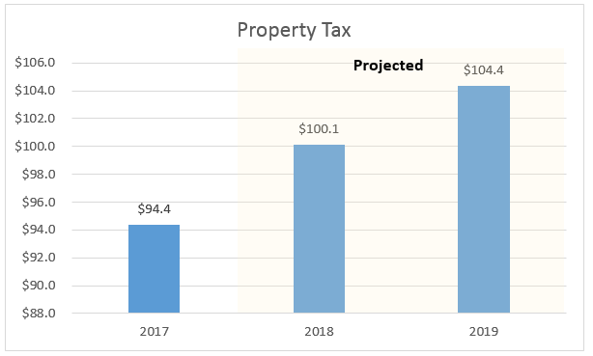
Property Tax
Value changes along with infill development in Newport Beach result in continued appreciation and strong growth in the foreseeable future
Historical growth recent years ranging between 6% to 8%
Positive AV growth during each of the last 20 years – average 6.9% annually
Average home sale price – $3.3 million, Median sales price – $2.5 million Q4 2017
Southern California sale prices have climbed back to the 2007 peak
Notes:
Vigorous Demand for Coastal property

Slide 4
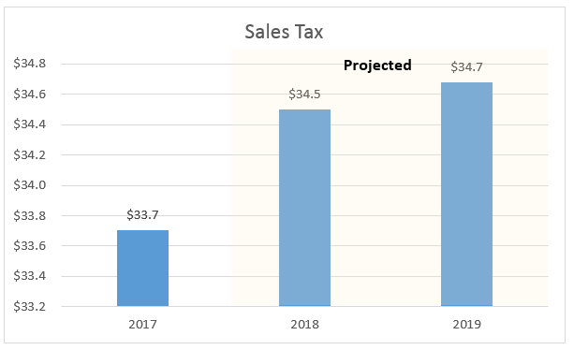
Sales Tax
Modest sales tax growth anticipated
Cyclical forces are slowing auto sales
Internet shopping is shifting sales tax away from brick-and-mortar stores

Slide 5
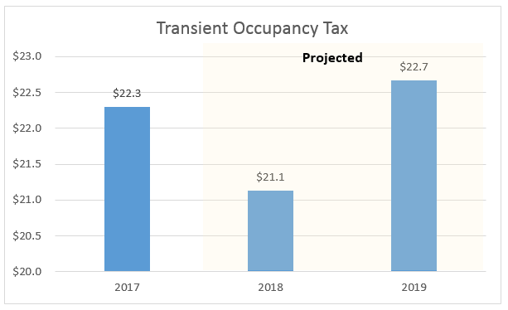
Transient Occupancy Tax
Revenue decline anticipated in FY 2018 due to simultaneous renovations of large hotels
Higher TOT revenue anticipated in 2019. (Commercial hoteliers optimistic, opening of Lido House hotel and Residential TOT growing especially with continued enforcement of online listing platforms)

Slide 6
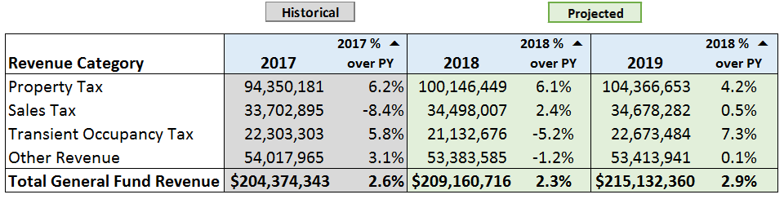
General Fund Revenue Trend
$6 million estimated increase to fund ongoing operational increases

Slide 7
Looking Ahead…

Slide 8
Still have funding challenges ahead...
Short Term
  Addressing homelessness
  Additional airport expenditures
Short and Long Term
  Public safety needs
  Pensions
    Ensuring we’ll be able to make ADPs
  Claims & Judgments
    Ongoing Funding Increase Recommended $4.2 million
    Unfunded Liability Shortfall $9.3 million
  Harbor Capital Plan and Seawall Funding
    Scheduled Funding Increase from $1.0 to $2.5 million

Slide 9
Unfunded Pension Liability
Components Impacting Unfunded Pension Liability |  | Amount
Actuarial Liability |  | 887,481,877
Market Value of Assets |  | 566,016,065
Unfunded Liability as of June 30, 2016 |  | 321,465,812
Impact of 7.25% Rate (1/8% Change) |  | 20,523,197
Impact of Excess Investment Earnings 2017 (11.2%) |  | (24,845,130)
Estimated Unfunded Liability as of June 30, 2017 |  | 317,143,879
Impact of 7.0% Rate (1/4% Change) |  | 30,805,734
Impact of Excess Investment Earnings 2018 (12%?) |  | (31,470,493)
Impact of Additional Discretionary Payments |  | (9,000,000)
Estimated Unfunded Liability as of June 30, 2018 |  | 307,479,120

Slide 10
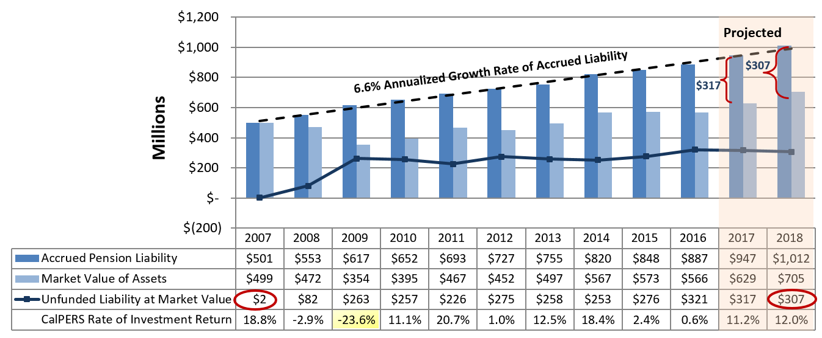
Unfunded Pension Liability Trend

Slide 11
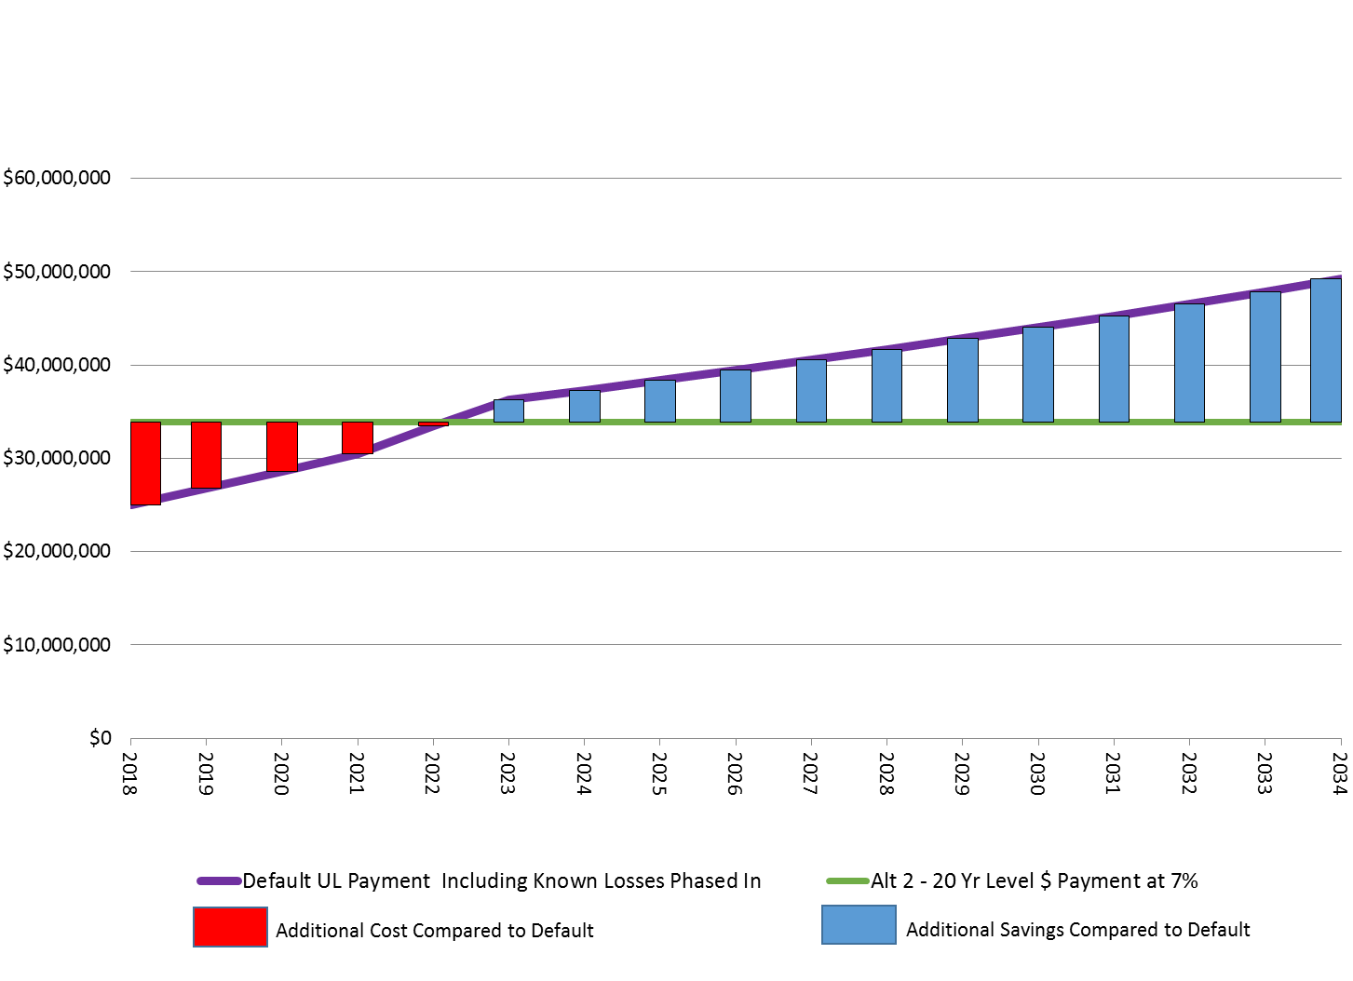
Unfunded Pension Liability -
(Level Dollar Payment Strategy)
↓We pay more here ↓
But we save more here ↑
Level dollar payment plan consumes a smaller % of the budget over time

Slide 12
Accelerated Payment History
 | FY 2015 | FY 2016 | FY 2017 | FY 2018 Estimated | FY 2019 Proposed Est. |  | Year Over Year $ Increase
Normal Cost | 14,627,830 | 14,899,906 | 15,424,068 | 16,178,468 | 16,766,294 |  | 587,826
Amortized Cost of Unfunded Liability | 12,783,847 | 21,524,369 | 21,265,608 | 24,958,890 | 25,698,507 |  | 739,617
Additional Discretionary Payment |  |  |  | 8,914,595 | 8,801,493 |  | (113,102)
Total Annual PERS Cost | 27,411,677 | 36,424,275 | 36,689,676 | 50,051,953 | 51,266,294 |  | 1,214,314
Employee Contributions | 7,429,842 | 8,401,598 | 9,447,341 | 10,083,183 | 10,324,540 |  | 241,357
Net Employer Cost | 19,981,835 | 28,022,677 | 27,242,335 | 39,968,770 | 40,778,144 |  | 972,984
Total Annual PERS Cost | 27,411,677 | 36,424,275 | 36,689,676 | 50,051,953 | 51,266,294 |  | 1,214,341
Fresh Start
Additional Discretionary Payments

Slide 13
Claims & Judgments
Actuarial Valuation Performed every two years
Higher Claims Experience in Workers Compensation – Safety Industrial Disability (Automatic Job Related Presumption )
Higher Claims Experience – Flores vs. City of San Gabriel
Certain costs not specifically associated with claims were not previously allocated to departments (Admin and Insurance)
Recommendations:
  Annual Actuarial Valuations
  Increase Department Charges
  Cash infusion

Slide 14
A Possible Allocation ($ Millions)
Uses |  |  |  | Sources
Description |  |  |  | Surplus | Estimated Revenue Growth | Total
 |  |  | Beg Bal | $12.50 | $6.00 | $18.50
Harbor Capital Plan |  |  |  | (4.00) |  | (4.00)
Pensions |  |  |  | (3.00) | (1.00) | (4.00)
Operations |  |  |  |  | (1.80) | (1.80)
Neighborhood Projects |  |  |  | (1.00) |  | (1.00)
General Liability |  |  |  | (3.00) | (2.20) | (5.20)
Workers Compensation |  |  |  |  | (1.00) | (1.00)
Contingency |  |  |  | (1.50) |  | (1.50)
 |  |  | End Bal | $0.00 | $0.00 | $0.00

Slide 15
Our Takeaways for Today…
January 2018 finds the City in good shape.
Revenues are strong with a strong reserve position
Good progress on pension issues
  2nd year coming up on ADP
  UAL may actually be going down…
We should be able to maintain our $5M in General Fund CIP – the “nuts and bolts”
Base operations funded
Challenges Remain
How long will good economic times last?
Changes in purchasing habits

Slide 16
Council Planning Session
Financial Update
January 29, 2018
Questions?

