Slide 1
Balboa Peninsula Pedestrian Crossing Study City Council Meeting – October 24, 2017

Slide 2
Summary of Crosswalk Study
Total of 38 un-signalized intersections with existing striped crosswalks were included in study.
Temporary video cameras used to observe and count activity.
Reviewed previous 5 years of collision history to determine frequency and patterns.
Despite the relatively high activity levels of visitors and residents, motorists, bicycles, and pedestrians interact in a generally safe and efficient manner.

Slide 3
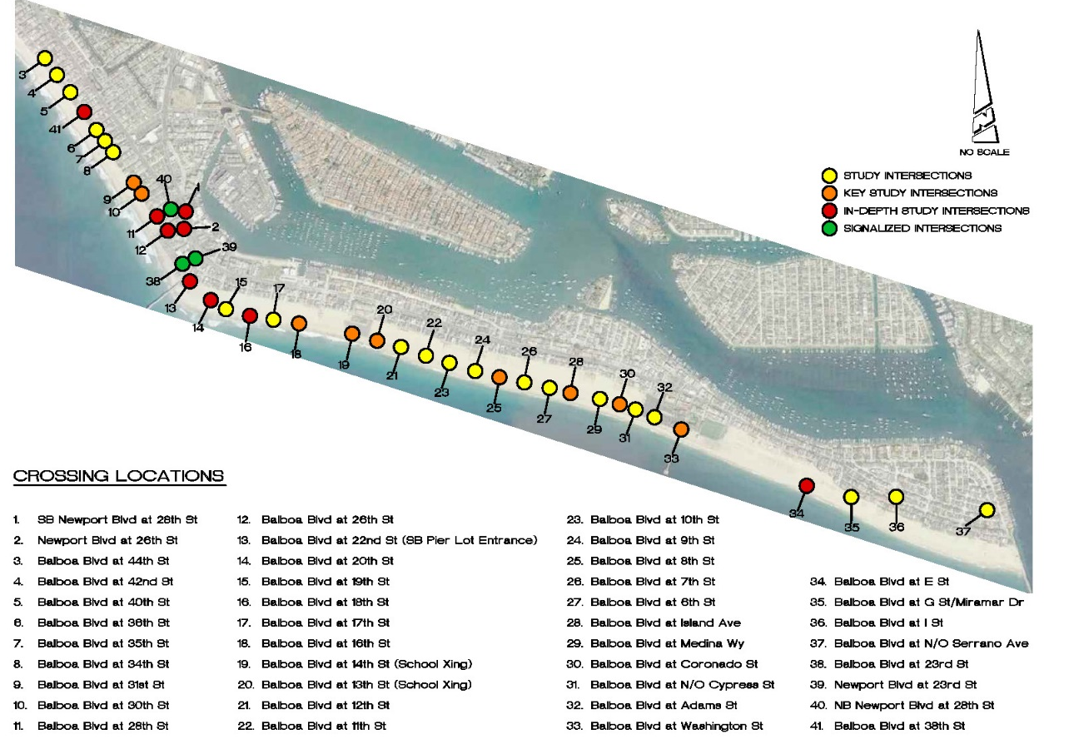

Slide 4
Pedestrian Crosswalk Improvements Studied
High Visibility Crosswalk Striping – continental bar marking
Pedestrian Caution Signs
Curb Extensions (Bulb-Outs)
In-roadway Flashing Lights
Flashing Beacons
Additional Overhead Roadway Safety Lighting
Maintaining/Increasing Clear Sight Distance – Red Curb & Parking Removal
Yield Markings (“Shark Teeth”)

Slide 5
Recommendations
General = For all crosswalks at intersections, added pedestrian caution signs and install upgraded high-visibility crosswalk striping. Install “Ped Xing” legends.
Specific Improvements = Physical improvements at high-activity locations. Removal of additional parking for sight distance. Installation of sidewalk extensions or bulb-outs. Add flashing beacon. Add more school warning signs near Newport Elementary.

Slide 6
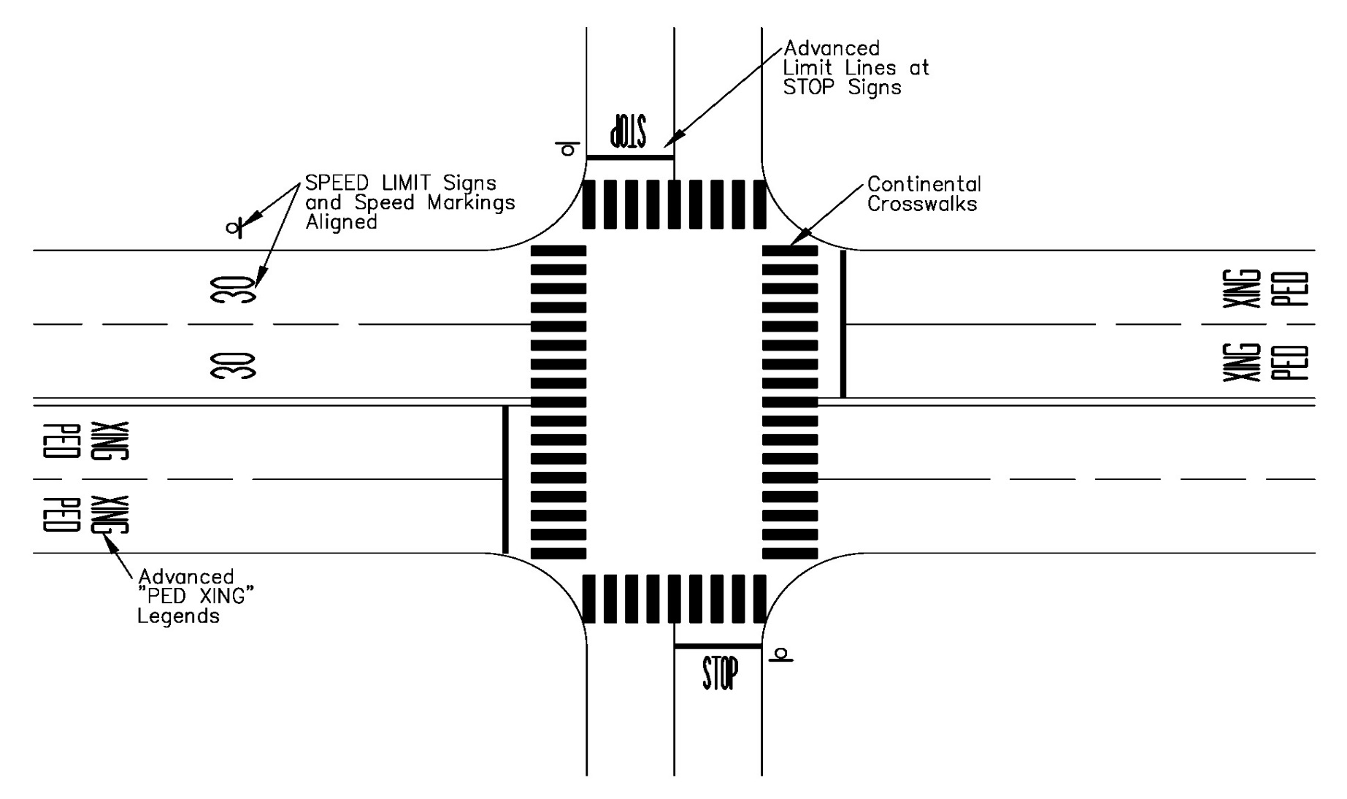
High-Visibility Crosswalk Striping

Slide 7
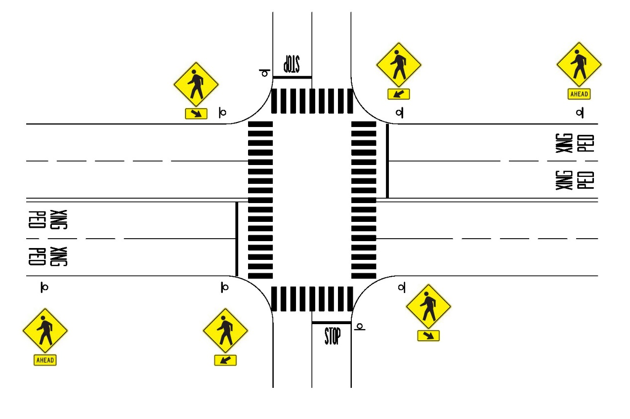
Pedestrian Caution Signs

Slide 8
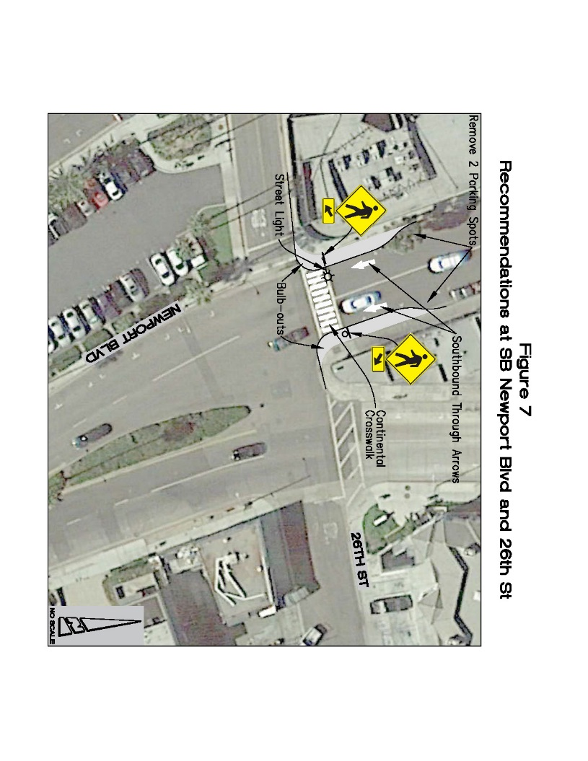
SB Newport Blvd. @ 26th = Bulb-Outs & Improve Visibility
Improvements:
Add bulb-outs
Add pedestrian caution signs
Remove 2 parking spaces
Add continental crosswalk striping
Add street light
Install SB through arrows

Slide 9
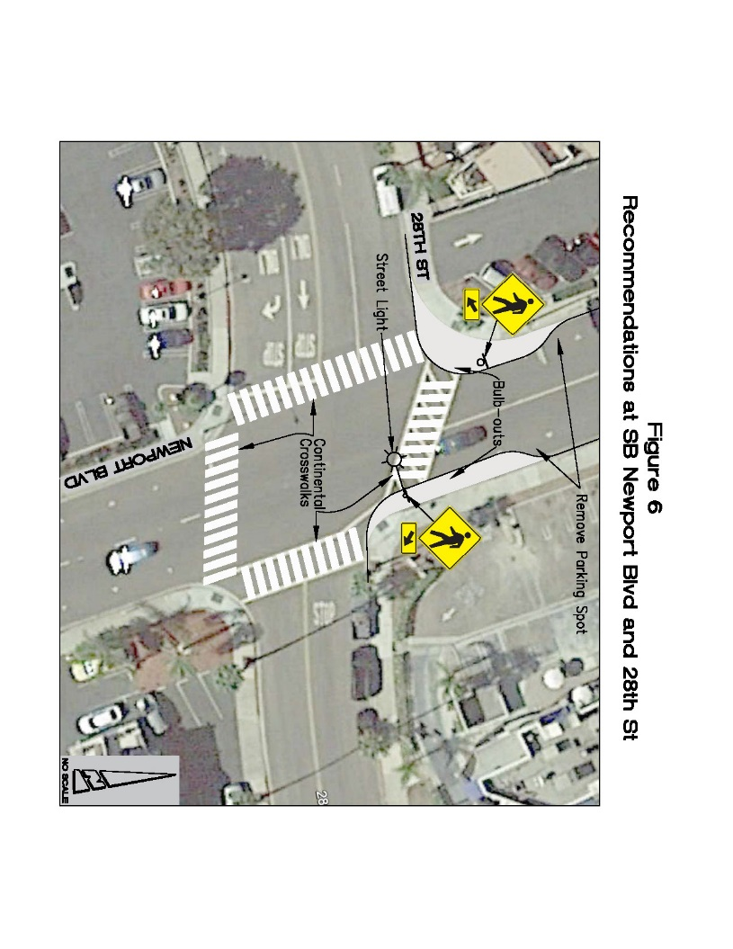
SB Newport Blvd. @ 28th = Bulb-Outs & Improve Visibility
Improvements:
Add bulb-outs
Add pedestrian caution signs
Remove 2 parking spaces
Add continental crosswalk striping
Stripe new crosswalks on south and west legs
Add street light

Slide 10
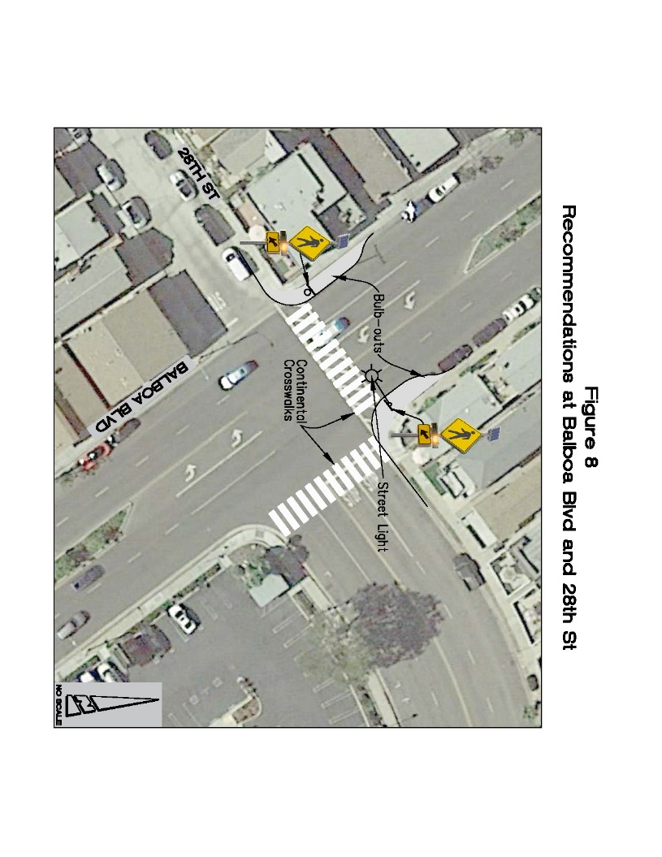
Balboa Blvd. @ 28th = Flashing Beacon & Bulb Outs
Improvements:
Add bulb-outs
Add pedestrian caution signs
Add continental crosswalk striping
Stripe new crosswalk on east leg
Add new street light
Install Rectangular Rapid Flashing Beacon (RRFB)

Slide 11
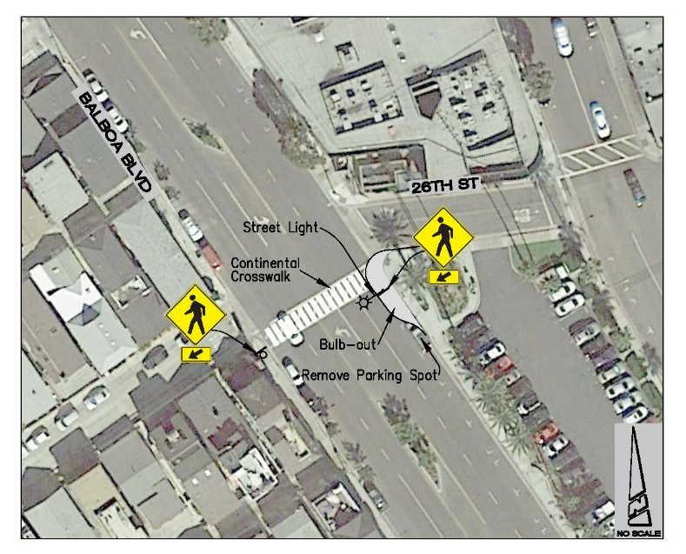
Balboa @ 26th = Bulb-Out & Improve Pedestrian Visibility
Improvements:
Add bulb-out
Add pedestrian caution signs
Add continental crosswalk striping
Remove one parking space
Add new street light

Slide 12
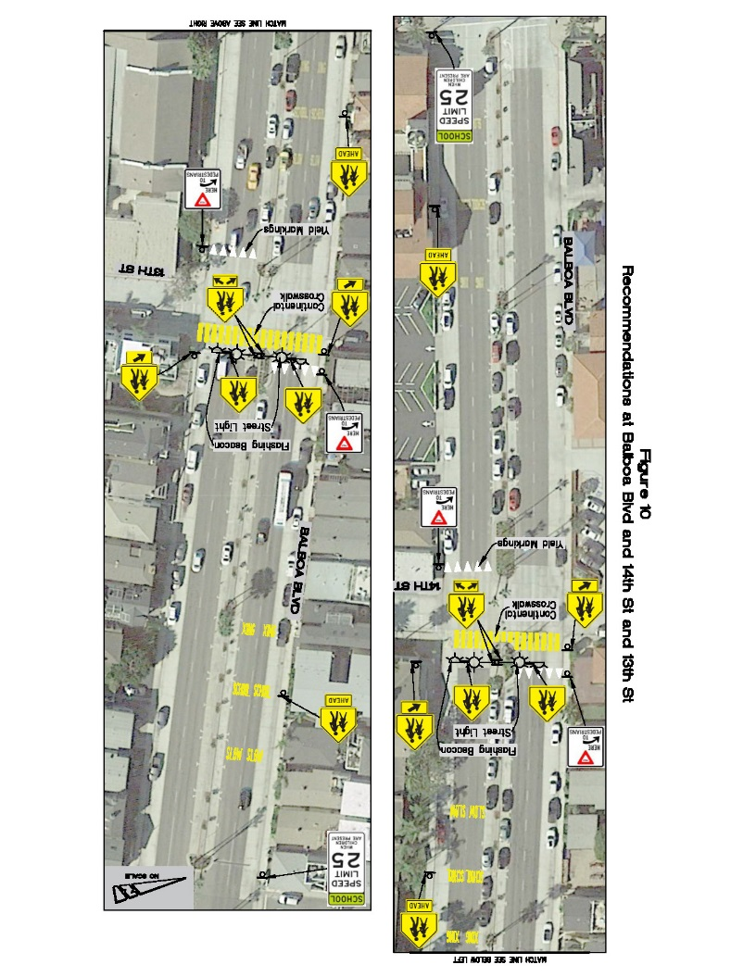
Newport Elementary = Flashing Beacons at 13th & 14th St.
Improvements:
Add new school crossing signs
Stripe “Slow School Xing” legends
Install overhead School Crossing signs with Flashing Beacons at both intersections
Install “Shark teeth” and “Yield Here to Pedestrian” signs
Stripe yellow continental crosswalks
Install new street lights
Install “25 mph When Children are Present” signs

Slide 13
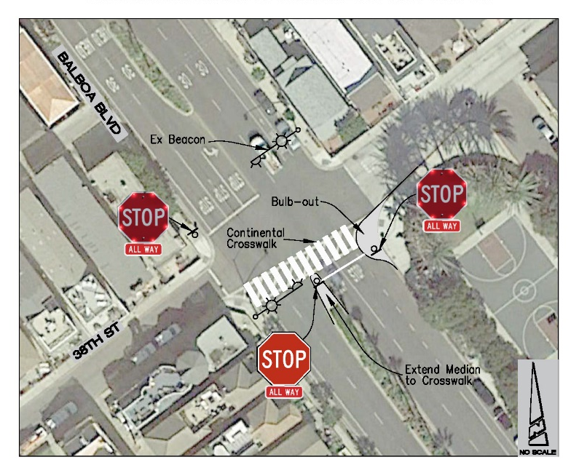
Balboa @ 38th Street = LED edge lit STOP signs
Improvements:
Add continental crosswalk striping
Install LED edge lit STOP signs for northbound and southbound (installed on July 26, 2017)
Proposed bulb-out
Extend median to improve visibility of STOP sign

Slide 14
California Vehicle Code – Section 21950
(a) The driver of a vehicle shall yield the right-of-way to a pedestrian crossing the roadway within any marked crosswalk or within any unmarked crosswalk at an intersection…
(b) This section does not relieve a pedestrian from the duty of using due care for his or her safety. No pedestrian may suddenly leave a curb or other place of safety and walk or run into the path of a vehicle that is so close as to constitute an immediate hazard.

Slide 15
Meetings and Schedules
City Council meeting – October 24.
Balboa Village Advisory Committee – September 20.
West Newport Beach Association Board – September 27.
Central Newport Beach Community Association – September 28.
Study available on City Website : newportbeachca.gov/crosswalkstudy
Phase 1 = Signing and Striping = Tentative Spring 2018
Phase 2 = Bulb-outs, Flashing Beacon, Street Lights = FY 18/19

